Slide 1
You can’t do Harm Reduction without fighting stigma
Jon Soske, 29 March 2023

Slide 2
Harm Reduction fights stigma by…

Slide 3
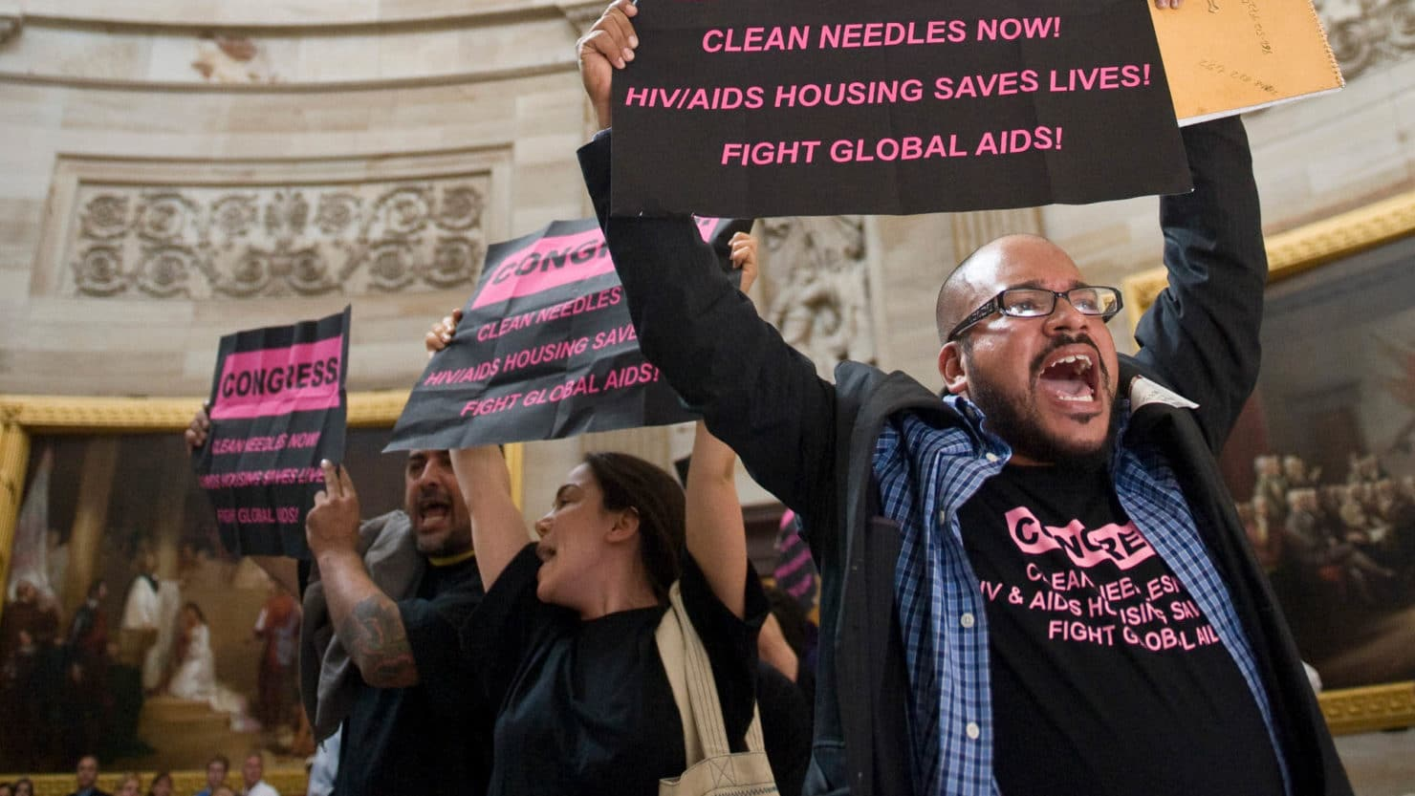
Building a Movement
Harm Reduction is a social movement led by people who use drugs to end the global drug war and transform our society’s attitudes toward substance uses.

Slide 4
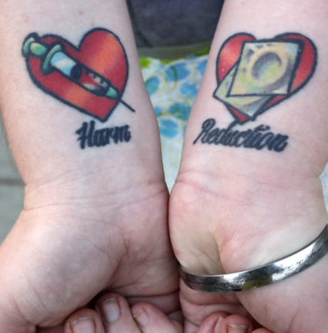
Love in Practice
Harm Reduction insists on the dignity and value of those society most despises: PWUD, people who are HIV positive. sex workers, the unhoused, the undocumented…

Slide 5
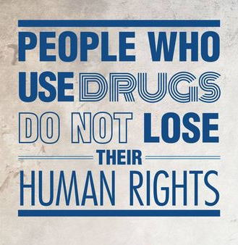
Affirming Choice
Harm Reduction affirms everyone has the capacity to make choices about their own lives & substance use.

Slide 6
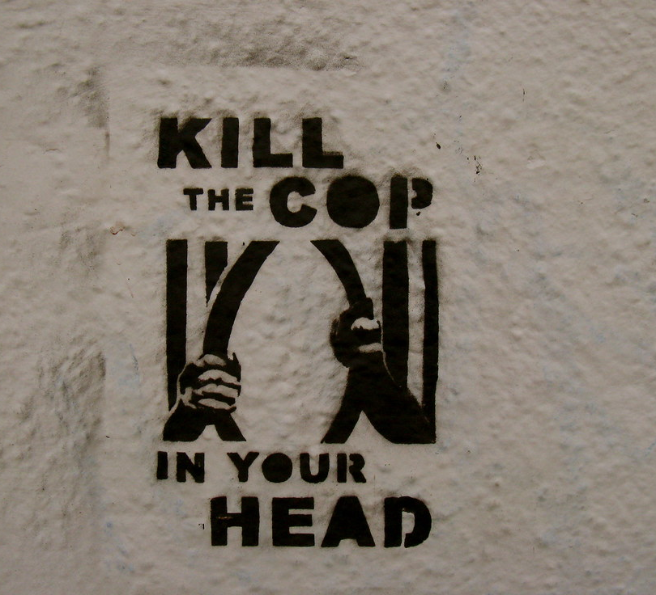
Unlearning Punishment & Control
Harm Reduction requires that we unlearn the fear-based responses of punishment & that operate at every level of the system.

Slide 7
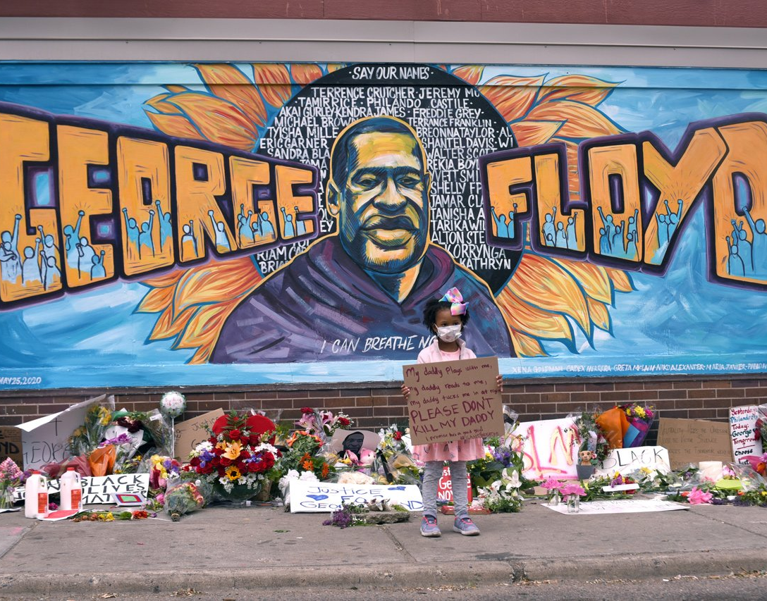
Demanding
Justice
Harm Reduction recognizes our society’s response to substance use has been as harmful, if not more harmful, than the impact of substances themselves.

Slide 8
Let’s talk about co-option

Slide 9
Harm Reduction vs. Risk Reduction?
Are people who use drugs in the leadership?
Do people who use drugs and the other despised know we have their backs?
Do we give people choices regarding the substance use and respect their choices?
Are we actively dismantling frameworks of punishment/control both at a program level and in our own emotional responses?
Are we centering the need for justice—both for today and yesterday’s harms?

Slide 10
What is stigma?

Slide 11
Stigma is related to, but is not….
Stereotype we can fix stereotypes in fighting them
Bias we have no proven tools to reduce bias
Discrimination fighting discrimination requires legal, social, & political change

Slide 12

Stigma is a Cycle
Stereotype/Bias + Power = Discrimination
Together these form a vicious cycle
The cycle is difficult to break at one point

Slide 13
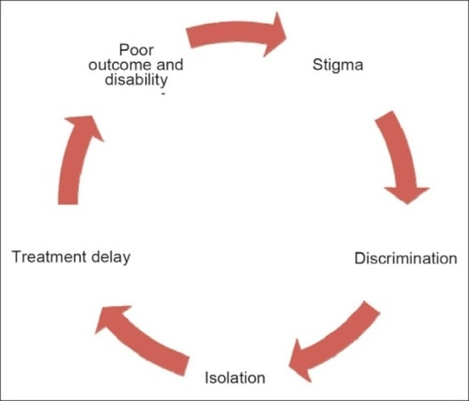

Slide 14
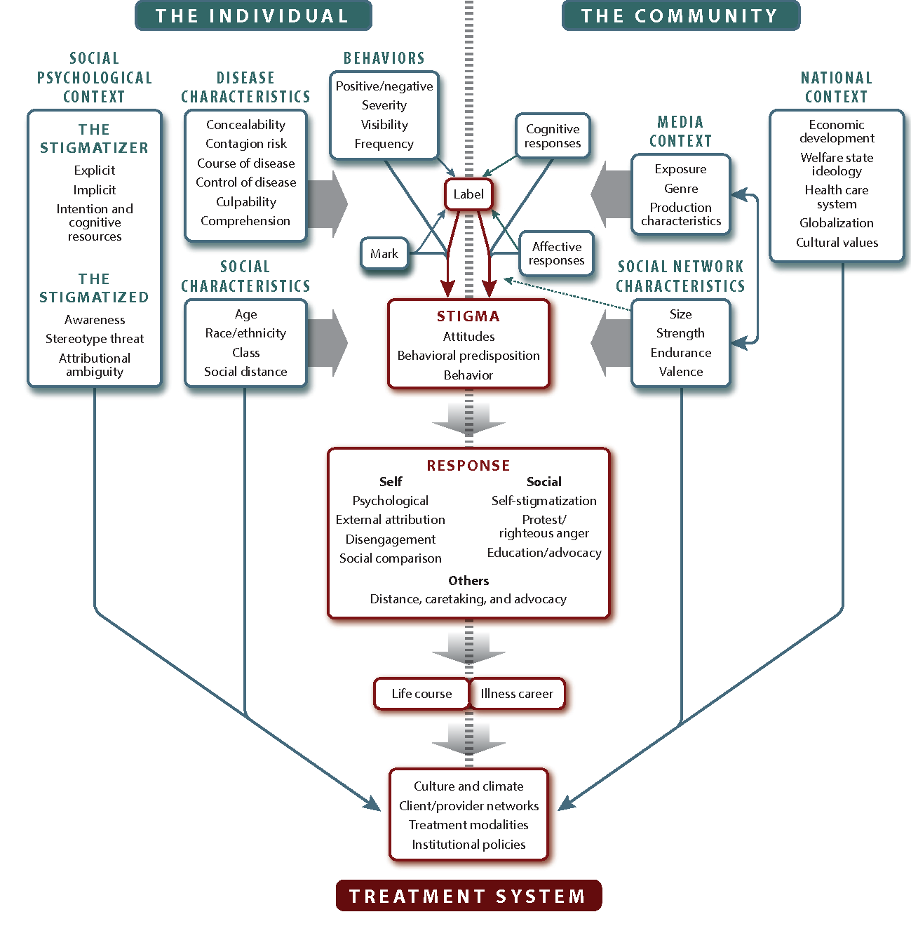
Stigma System
State
Media
Institutions
Community
Family
Individuals

Slide 15
Destigmatize what?

Slide 16
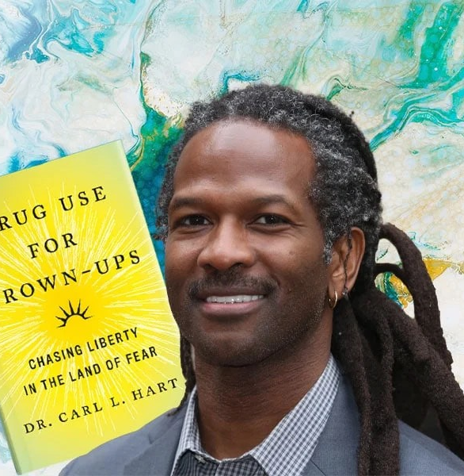
Substance use is not addiction
We need to end a fear & morality based approach to drugs

Slide 17
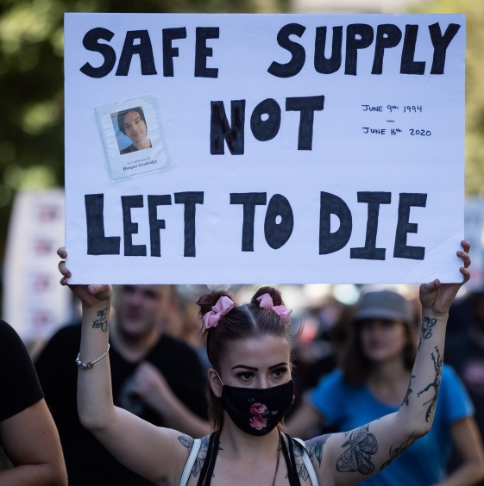
But it’s more complicated than that….
In 2021, 1.1 million people used heroin. 1 million met criteria for OUD

Slide 18
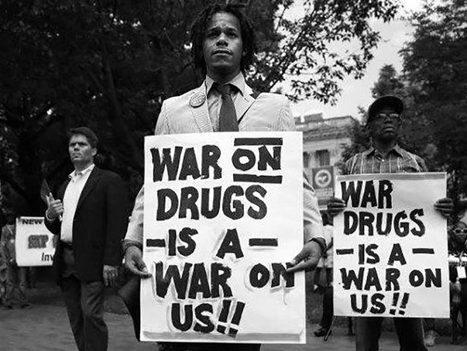
It’s never been about addiction or drugs
HR allows us to embrace complexity

Slide 19
What works?

Slide 20
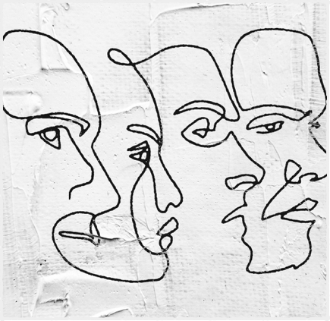
Organizational Change?
General Principles
Leadership Support
Equal Status
Common Goal
Trainings show little effectiveness
We can start fighting for anti-stigma policies

Slide 21
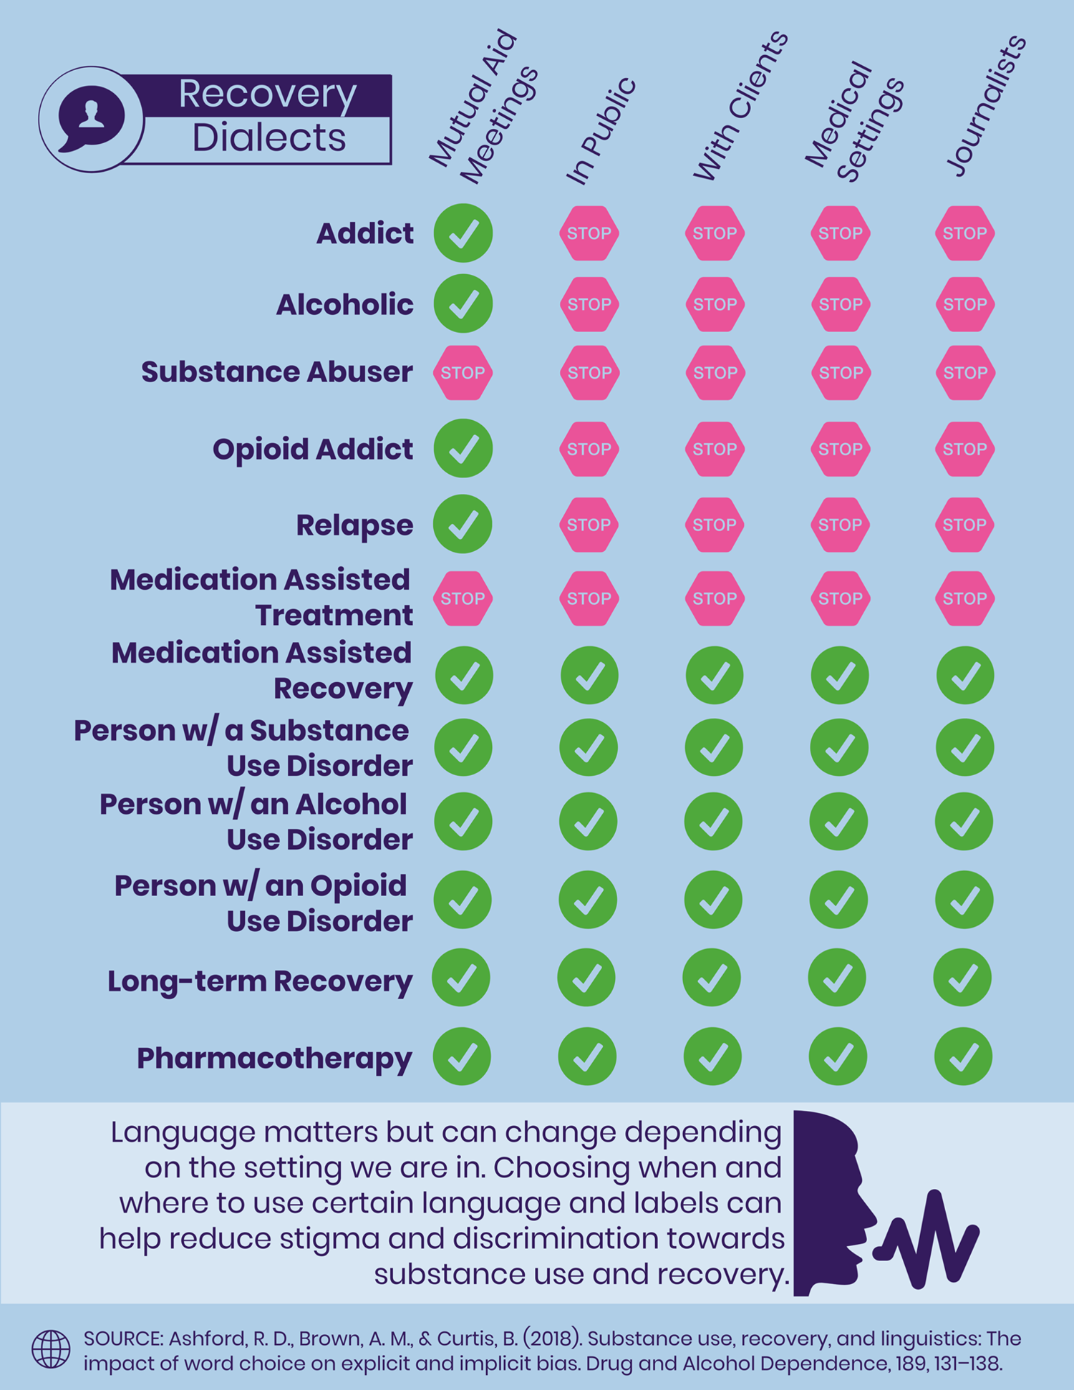
Change Our Language
Evidence shows stigmatizing language promotes discrimination.

Slide 22
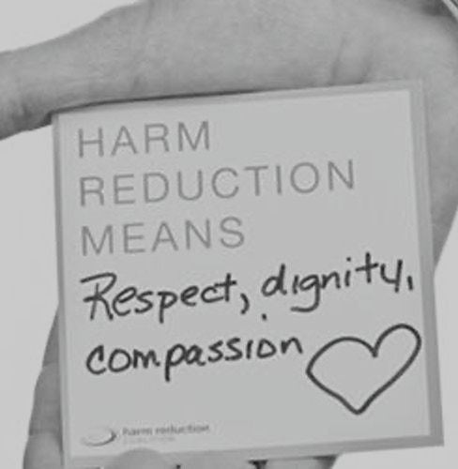
Fight Back
Self-advocacy can counter internalized stigma & learned helplessness

Slide 23

Know the Law
New guidelines for the American with Disabilities Act clarify discrimination is illegal.

Slide 24
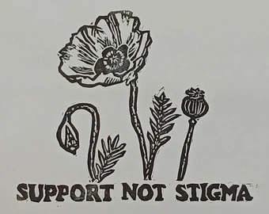
Be Objective
We can reinforce each other’s trauma & magnify learned helplessness

Slide 25
Don’t blame the system when we fail our own

Slide 26
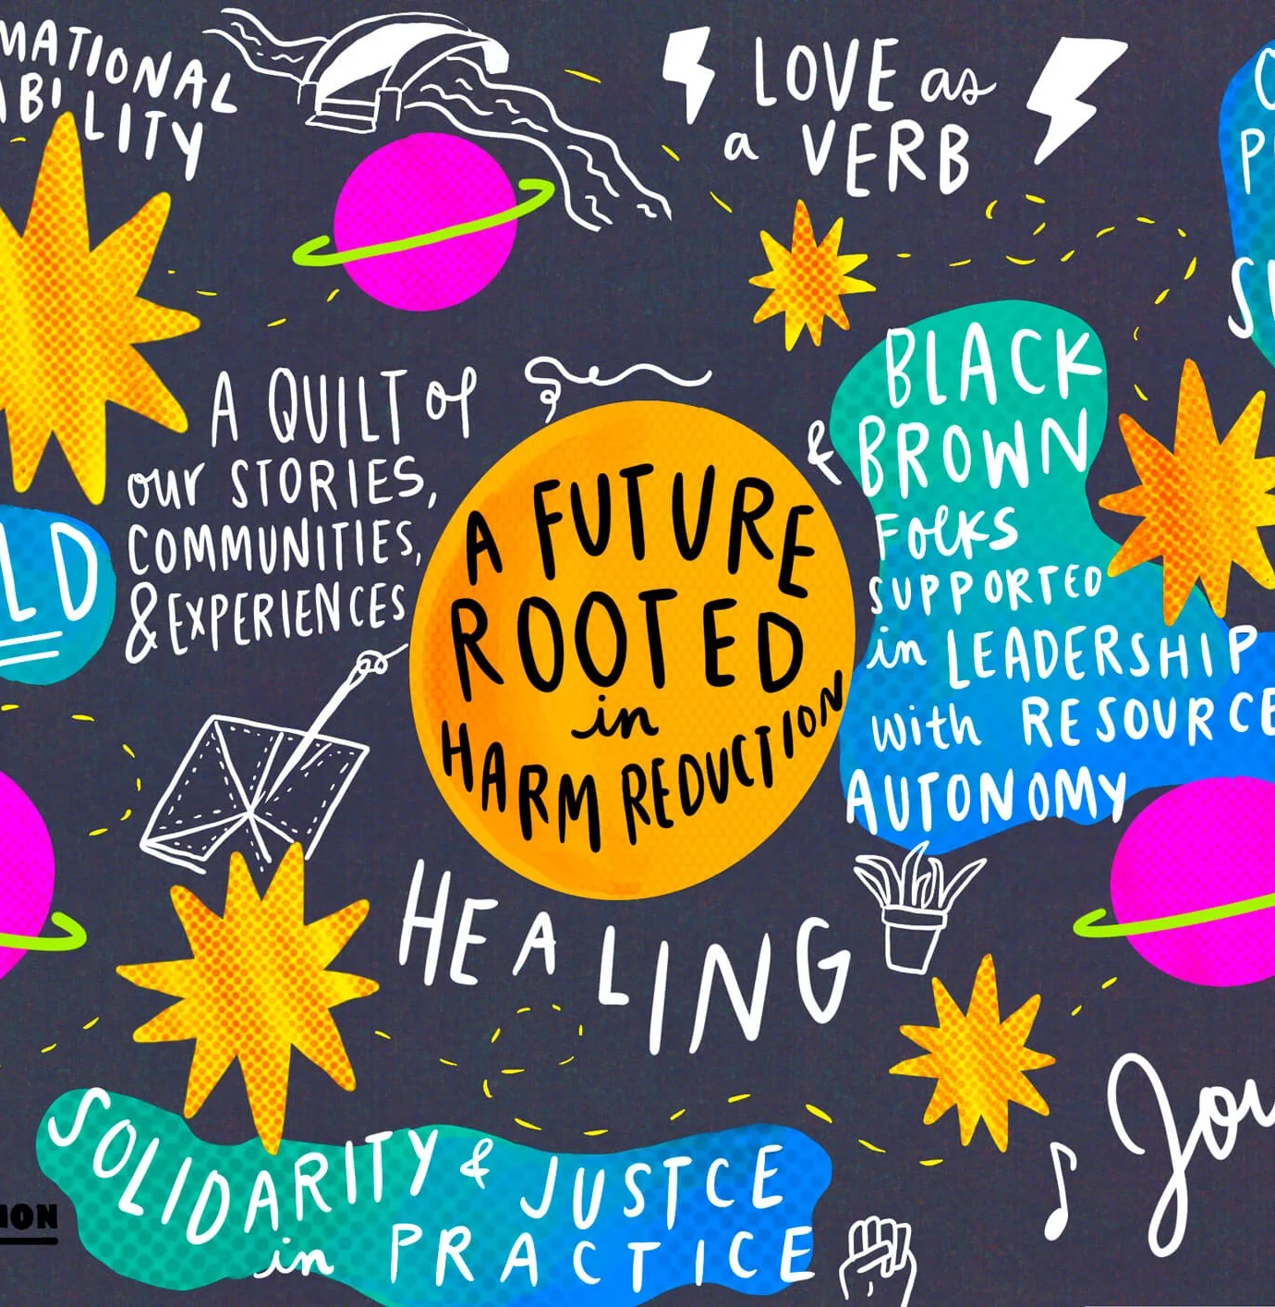
Looking Inward
If we truly believe that stigma is a structural issue, then we cannot assume that our own organizations are immune.

Slide 27

Scapegoating chaos &
Deflecting burnout

Slide 28
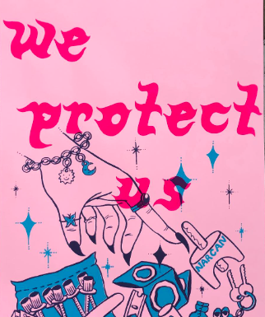
Radical Self-love
HR starts with ourselves

