Slide 1
Overdose education and naloxone distribution

Slide 2
Objectives
Discuss
Discuss the issues of opioid use and mortality across the country and Rhode Island
Identify
Identify risk factors for overdose
Provide
Provide tools to recognize and respond effectively to an overdose
Administer
Administer naloxone to an individual thought to be experiencing an overdose.
Support
Support Ventilation and Monitor individual for responsiveness.

Slide 3
Opioids and Overdose Nationwide

Slide 4
Opioids and Overdose
The CDC estimates that 81,230 drug overdose deaths occurred from June 2019 to May 2020
222 people die each day from overdose
in the US

Slide 5
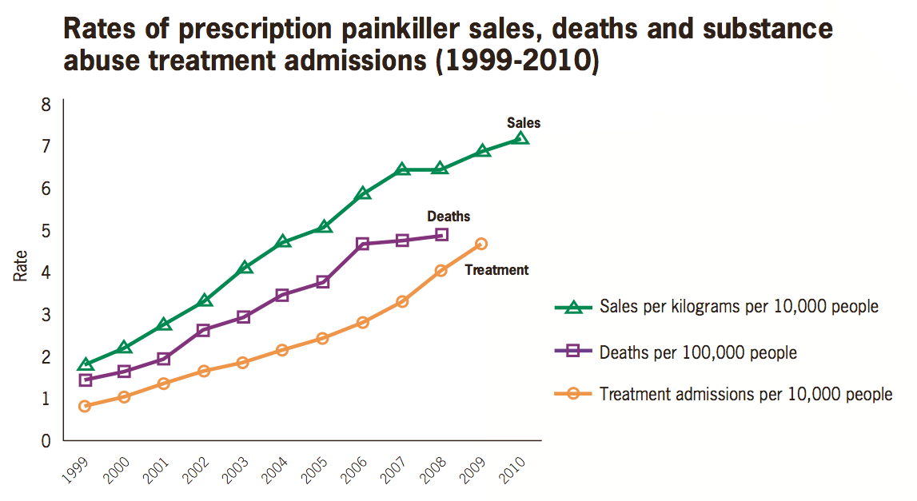
How did we get here
Rates of prescription painkiller sales, deaths, and substance use treatment admissions (1999-2010)
National Vital Statistics System, 1999-2008; Automation of Reports and Consolidated Orders System (ARCOS) of the Drug Enforcement Administration (DEA), 1999-2010; Treatment Episode Data Set, 1999-2009
Notes:
How did we get here….. The rise in opioid overdose and fatalities correlates to increased sales of prescription pain medications. Though only a small percentage of people who are prescribed opioids develop opioid use disorder, dramatically increasing the number of people who are exposed to opioids (both through prescription and diversion to other community members), also increases the total numbers of people who will develop opioid use disorder.

Slide 6
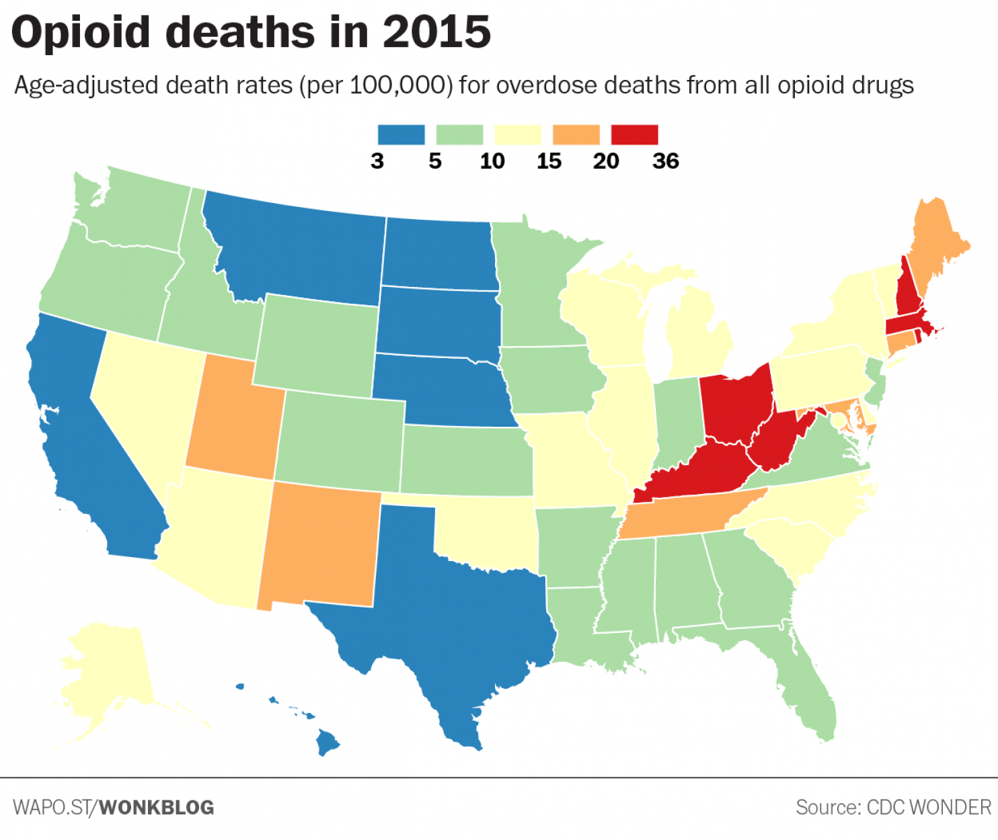
Washington Post December 13, 2016 https://www.washingtonpost.com/news/wonk/wp/2016/12/13/where-opiates-killed-the-most-people-in-2015/?utm_term=.a08cb4821be4

Slide 7
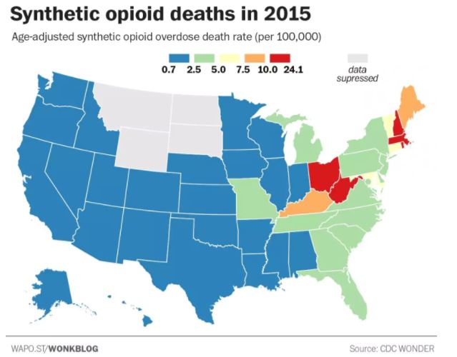
Washington Post December 13, 2016 https://www.washingtonpost.com/news/wonk/wp/2016/12/13/where-opiates-killed-the-most-people-in-2015/?utm_term=.a08cb4821be4

Slide 8
Opioids and Overdose in rhode island

Slide 9
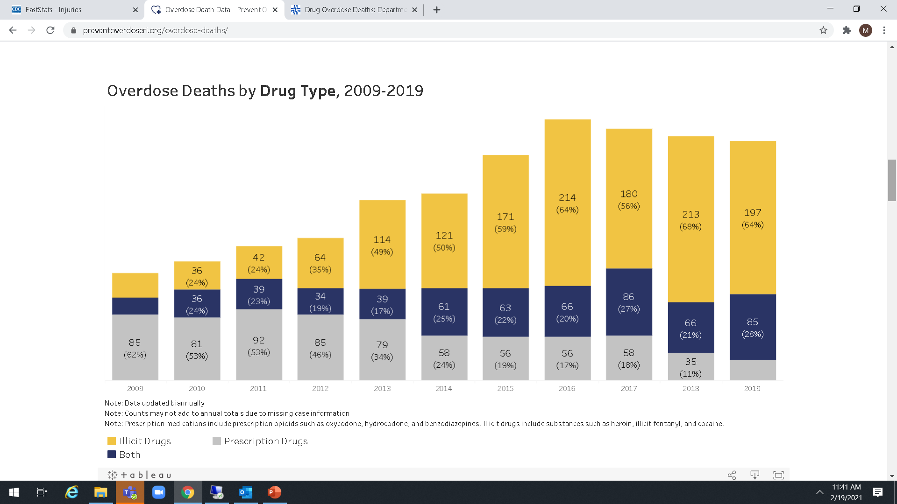
RI Fatal Overdoses 2009-2020
>400
projected
336
324
314
308
290
232
240
183
2020
Notes:
This is a busy slide and shows the many waves of the crisis (it is a dynamic epidemic). 1) preventoverdoseri.org is a terrific resource! 2) prescription overdose deaths (in grey)show a decline; 3) 2013-2015 heroin deaths on the rise; 4) 2015 onwards fentanyl deaths on the rise (in 2018, fentanyl was present in 70% of fatal overdoses). While we saw an approximate 8% decline in overdose fatalities 2017-2019, in 2020 RI experienced the highest number of fatal overdoses to date with deaths estimated to exceed 400 (final number won’t be available until April 2021).

Slide 10
Rhode Island Overdose Age and Gender
The highest rates of fatal overdoses occur in men between 30 and 60 years old.
Most overdose fatalities in women occur in this age range as well. Women currently make up one third of overdose deaths in all age ranges.
There is currently not good reporting of people who identify as non-binary.
Notes:
These next few slides provide a few more details regarding fatal overdose in RI – specifically regarding age and gender.

Slide 11
Fentanyl Deaths by Age Group
33%
22%
Fentanyl is impacting all age groups, but particularly younger people.
Source: https://preventoverdoseri.org/overdose-deaths/
Notes:
Throughout this presentation, overdose death refers to overdose fatalities from all substances (not just opioids). Opioid fatalities accounted for 90% of overdose fatalities in 2014 and 83% in 2019. In both 2014 and 2019, the ages 45-54 were particularly impacted by cocaine (50% and 69% respectively). 55 and older is more impacted by prescribed opioids (in 2019, 83% of fatalities were related to prescribed opioids)

Slide 12
Opioids tolerance DEPENDENCE

Slide 13
OPIOIDS
STRONG OPIOID AGONISTS
morphine
fentanyl
methadone
heroin
hydromorphone (Dilaudid)
oxycodone (Oxycontin, Percocet*)
meperidine (Demerol)
MODERATE OPIOID AGONISTS
codeine
hydrocodone (Vicodin*)
OTHER OPIOID AGONISTS
tramadol (Ultram)
dextromethophan
PARTIAL OPIOID AGONIST
buprenorphine
buprenorphine+naloxone (Suboxone)
OPIOID ANTAGONISTS
naloxone (Narcan)
naltrexone
*contains acetaminophen (Tylenol)

Slide 14
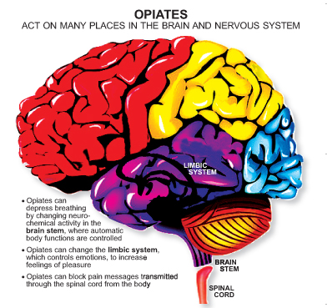
Opioids In the Central Nervous System

Slide 15
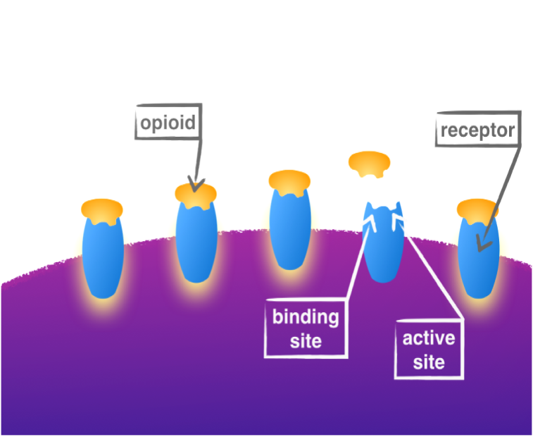
Tolerance
Opioids bind at opioid receptors causing a spectrum of therapeutic, pleasurable, and potentially dangerous effects.
Repeated exposure to opioids (for any reason) desensitizes opioid receptors.
It will now take more opioid to cause the same effect.
Notes:
https://www.drugabuse.gov/publications/media-guide/science-drug-use-addiction-basics

Slide 16
Decreased Tolerance
When opioid receptors are not exposed to opioids for any period of time, the receptors return to baseline.
It will now take less opioid to cause the same effect.
If the same amount of opioid is given, it will cause a stronger reaction.

Slide 17
Physical Dependence
Physical dependence is when the body requires a specific dose of a drug in order to prevent withdrawal symptoms.
Notes:
https://www.drugabuse.gov/publications/media-guide/science-drug-use-addiction-basics
People develop tolerance to prescription medications in a fairly short period of time (sometimes in as little as 5 days) and must be tapered from their highest dose to avoid experiencing discomfort and withdrawal when they stop taking prescription opioids.

Slide 18
Opioid Use Disorder

Slide 19
Opioid Use Disorder (OUD)
Severe OUD is a chronic and reoccurring condition characterized by a change in the structure and function of the brain.
The evidence-based treatment of OUD is multifaceted and often includes pharmaceutical treatment, such as methadone, buprenorphine and naltrexone.
Notes:
ASAM opioid use disorder checklist https://www.asam.org/docs/default-source/education-docs/dsm-5-dx-oud-8-28-2017.pdf?sfvrsn=70540c2_2
https://www.drugabuse.gov/publications/misuse-prescription-drugs/what-classes-prescription-drugs-are-commonly-misused

Slide 20
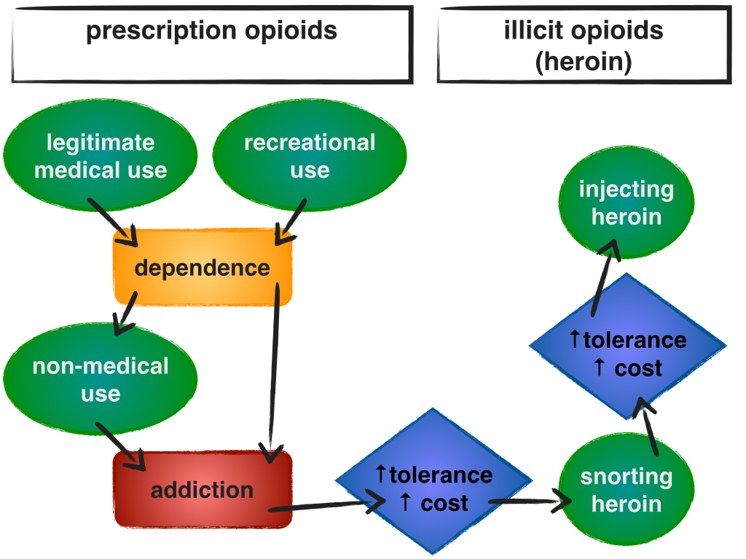
80% of new heroin/fentanyl users start with prescription pain medications
heroin/fentanyl
medical use
social use
Injecting heroin/
fentanyl
snorting heroin/
fentanyl
SAMHSA
Graphic: NOPE-RI

Slide 21
Overdose Risk Factors Naloxone

Slide 22
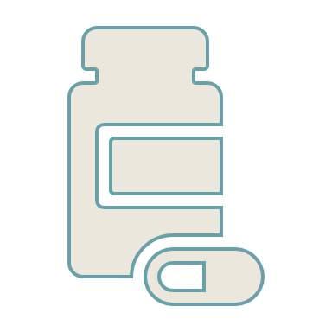
Overdose
An overdose occurs when a toxic amount of a drug or a toxic combination of drugs overwhelms the body.
Toxicity depends on multiple factors, including acute and chronic illness.
Opioid overdose is characterized by inadequate breathing (respiratory depression).
This leads to a lack of oxygen in the body which will lead to death if no intervention is made.

Slide 23
Overdose Risk Factors
There is an increased likelihood of overdose when any of the following factors are present:
Decreased tolerance due abstinence
incarceration
detox
Prior nonfatal overdose
High dose prescription
Using illicit opioids alone
Mixing of prescription/illicit opioids
with benzodiazepines (i.e. Xanax)
with alcohol
with cocaine (or other uppers)
with other substances (i.e. fentanyl)
Compromised health conditions
Hepatitis C
HIV/AIDS
Pneumonia, flu or other acute illness
sleep apnea
other liver or respiratory conditions
Notes:
People lose tolerance to opioids if they stop taking opioids for any reason, including treatment or detox that is not accompanied by medications (i.e. buprenorphine, methadone or naltrexone). So, if the person has a reoccurrence of opioid use, they are at increased risk of overdose, because their body cannot tolerate the same amount they used before.

Slide 24
Naloxone (Narcan)
is used to reverse opioid overdose.
is a non-addictive, prescription drug.
only works on opioids. However, if there are multiple drugs in the system, it can help restore breathing.
can be given as an injection (IM) or as a nasal spray (IN) by lay people.
effect has an onset of 2-4 minutes and a duration of 30- 90 minutes.
is very safe.
Multiple doses of naloxone are often REQUIRED because of fentanyl.
Notes:
It has a stronger affinity for opioid receptors than opioids and therefore reverses and blocks their effects. There are no adverse effects to naloxone if administered to someone not overdosing on opioids. People who overdose may have different types of drugs in their system

Slide 25
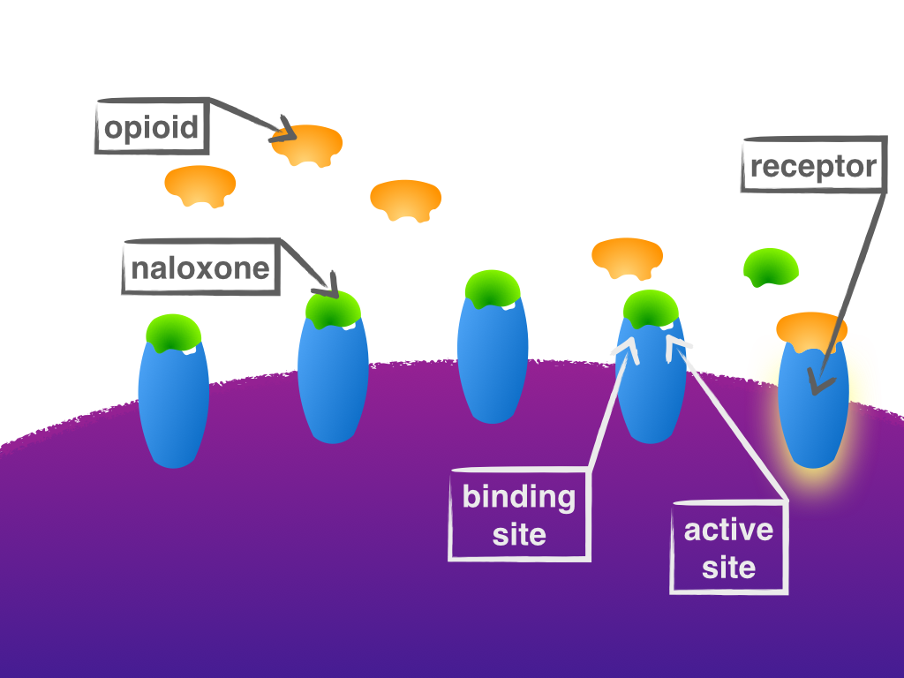
Naloxone
Naloxone works by “pushing” opioids off their receptors.
It then binds to the opioid receptors and blocks opioids from binding.
This rapid removal of opioids from receptors can cause symptoms of withdrawal, although the severity varies from person to person.
The opioids have NOT been removed from the body and re-attach as the naloxone wears off in 30-90 minutes.

Slide 26
Storing Naloxone
All naloxone products have an expiration HOWEVER – any naloxone is better than no naloxone.
Naloxone should be stored out of direct light.
Naloxone prefers to be kept at room temperature (59-86°F or 15-30°C). It should not be stored in a refrigerator or a vehicle glove box or trunk.
If naloxone is stored improperly, it loses some effectiveness. It does not become harmful if administered.

Slide 27
Overdose Assessment and Response

Slide 28
Fatal Overdose is Preventable
You are the help until help arrives!!
SURGEON GENERAL ADVISORY
https://www.hhs.gov/surgeongeneral/priorities/opioids-and-addiction/naloxone-advisory/index.html
Notes:
Dr. Jerome Adams issued a surgeon advisory urging Americans to carry naloxone.

Slide 29
Overdose Response
Evaluate for an Overdose
Call 911*
Administer naloxone, if available*
Support Ventilation
* If two people available, one call 911, one administer naloxone
If no response after 2-3 minutes, give 2nd dose of naloxone

Slide 30
Evaluate for an Overdose
Can't be woken up (unresponsive) | Pale/Ashen skin
Slow or no breathing (may sound like snoring) | Fingernails or lips turning blue
Notes:
Overdose victim may also have a stiff or rigid upper body – this is sometimes a symptom of fentanyl exposure

Slide 31
CALL 911*
AN OPIOID OVERDOSE NEEDS IMMEDIATE MEDICAL ATTENTION.
Be sure to give a specific address and/or description of your location.
* If two people available, one call 911, one administer naloxone

Slide 32
Administer naloxone*
If two people available,
one call 911
one administer naloxone

Slide 33
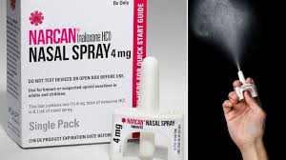
NARCAN Nasal Spray
Remove the device from the package. Hold with thumb on the bottom of the plunger with your first and middle fingers on either side of the nozzle.
Tilt the person’s head back and provide support to the neck then insert the tip of the nozzle into nostril until your fingers are against the person’s nose.
Press the plunger firmly to give the dose.

Slide 34
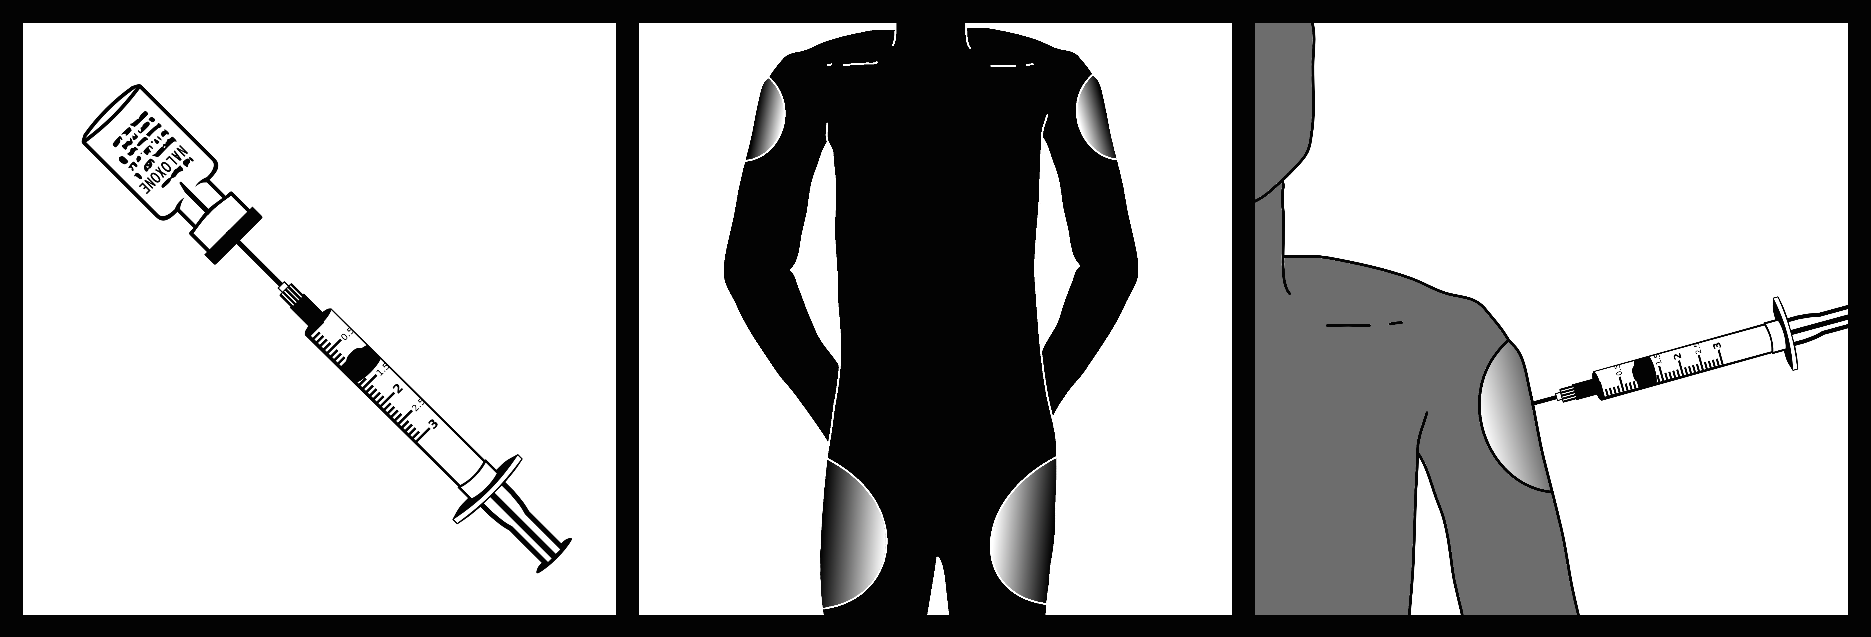
IM Naloxone
Remove cap from naloxone vial and syringe
Insert needle through rubber plug
Pull back on plunger until there is 1cc in the syringe
Inject into a large muscle (thigh or upper arm)

Slide 35
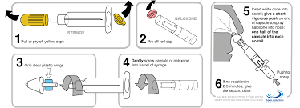
Intranasal Naloxone (3-step)
Remove both yellow caps from the ends of the syringe
Twist the nasal atomizer onto the tip of the syringe
Remove the purple cap from the naloxone vial
Twist the naloxone into the bottom of the syringe until you feel resistance

Slide 36
Support Ventilation
Breathing support is an important intervention and may be lifesaving on its own (if naloxone is not available).
Rescue breathing, CPR and/or chest compressions can provide vital support to the individual and improve outcomes.
Notes:
These instructions hold true during COVID-19 as well. People may be less comfortable providing rescue breaths but can support ventilation with chest compressions.

Slide 37
How to Provide Ventilation Support
BASED ON YOUR LEVEL OF TRAINING or COMFORT:
Rescue Breaths
CPR
Full Chest Compression + Rescue Breaths (30 to 2)
Chest Compression Only (100 per minute)
To be fully prepared in the case of an emergency, enroll in a local CPR training.
Notes:
In the instance of a witnessed opioid overdose, rescue breathing is the primary treatment and should be performed after administering naloxone. CPR is a more reliable rescue mechanism if you are unsure of when or if an overdose has occurred. It “covers all the bases” if we aren’t certain of the overdose.

Slide 38
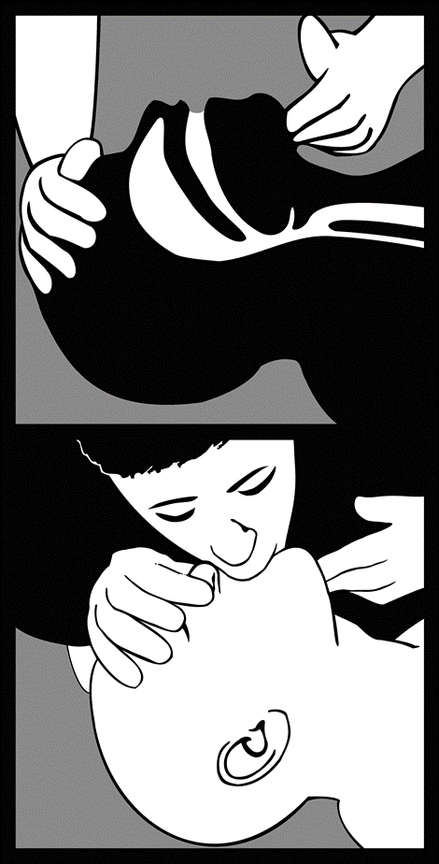
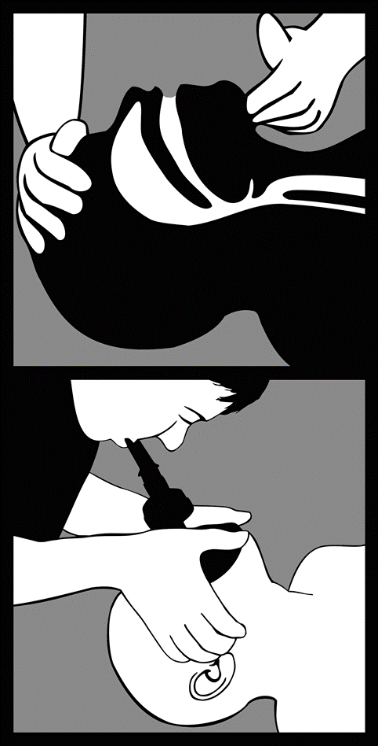
Rescue Breathing
Place one hand on the person’s chin, tilt the head back, and pinch the nose closed.
Place your mouth over the person’s mouth to make a seal and give two slow breaths.
Watch for the person’s chest (but not the stomach) to rise.
Follow up with one breath every 5 seconds.
Continue until help arrives or the person starts breathing on their own.
Use a barrier device, if you have one.

Slide 39
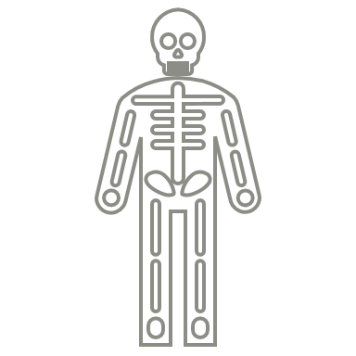
Chest Compressions
Chest compressions for adults involve the following steps:
Place the person on his or her back.
Press hard and fast on the center of the chest.
Interlock fingers.
Keep your arms extended.
Notes:
Shoulders over hands.

Slide 40
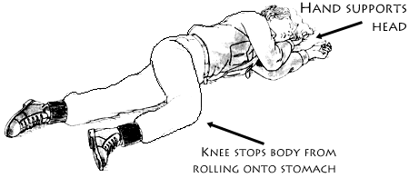
Recovery Position
When To Use The Recovery Position:
If You have to leave for any reason
If the individual begins breathing but remains groggy.
First Responder Training / MADPH
Notes:
If for any reason the victim needs to be left along place in recovery position

Slide 41
Possible Naloxone Responses
Breathing improves and person becomes responsive within 2-3 minutes
Person starts breathing within 2-3 minutes but remains groggy and not fully responsive
Person does not respond to first dose and naloxone must be repeated in 2-3 minutes (continue to provide ventilation support)

Slide 42
Efforts to address the crisis

Slide 43
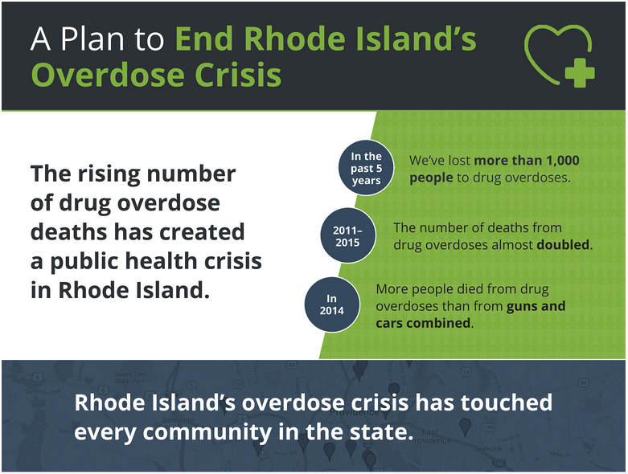
RI Strategic Plan
Notes:
http://preventoverdoseri.org/our-action-plan/

Slide 44
Harm Reduction
Harm reduction refers to public health efforts to minimize harm associated with drug use (or other behaviors), rather than a focus on abstinence from drug use.
Examples of harm reduction programs include:
needle/syringe exchanges
drug testing services (i.e. fentanyl test strips)
decriminalization of drug use
prescribed heroin
overdose prevention centers
information and education

Slide 45
Harm Reduction
Overdose prevention education and naloxone distribution (OEND) are feasible and cost-effective methods that have been shown to reduce fatal overdose in communities and increase enrollment in drug treatment.
Lay responders, armed with knowledge, skills, and resources, are willing and able to identify an overdose and administer naloxone, resulting in lives saved.

Slide 46
Naloxone Distribution in RI
Notes:
https://preventoverdoseri.org/naloxone-data/
This increase has been due to consistently increasing community distribution of naloxone and in 2018 the law change that requires co-prescription of naloxone with prescription opioids.
http://webserver.rilin.state.ri.us/BillText18/SenateText18/S2930.pdf

Slide 47
Liability / Good Samaritan Law
Civil and criminal immunity for the “good faith” administration of naloxone by a layperson to someone experiencing an overdose.
Anyone who seeks medical assistance for someone experiencing an overdose (e.g. calling 911, performing rescue breathing, administering naloxone) will not be charged with drug possession.
Anyone who experiences a drug overdose and needs medical assistance will not be charged with drug possession.
Neither of these immunities extend to manufacture or distribution of drugs.
The act of providing medical assistance (e.g. calling 911, performing rescue breathing, administering naloxone) may be used as a mitigating factor in criminal prosecution.

Slide 48
Standing Order
Individuals can request, and pharmacists can dispense naloxone without a specific prescription.
There is no age restriction.
Almost all pharmacies in the state are participating.
All insurance, including Medicaid are required to cover the cost of naloxone except for co-pay.
Notes:
It doesn’t have to be for you.

Slide 49
Frequently asked questions

Slide 50
Frequently Asked Questions
What are the side eﬀects of naloxone?
Naloxone reverses opioid overdose and causes withdrawal. The most common symptoms of withdrawal are pain, nausea, vomiting, sweating, and anxiety. Less common are agitation, seizures, or irregular heartbeat. While opioid withdrawal can be dramatic and unpleasant, it is not life threatening.
Can people have violent reactions after naloxone administration?
It is possible an individual will become agitated and combative after going into withdrawal due to naloxone administration, however this is not likely with the relatively small dose (.4 mg IM or 4mg IM) administered in intervals by lay responders.

Slide 51
Frequently Asked Questions
Does naloxone work on cocaine, methamphetamine, benzodiazepines, or alcohol?
No. Naloxone only works on opioids (heroin, morphine, fentanyl, methadone, etc). It will not have any effect on someone overdosing on another type of drug. However, if someone is overdosing on opioids AND another drug, naloxone will reverse the opioid part of the overdose and potentially help the person.
What if naloxone is given to someone who doesn't have any opioids in their system?
There are no adverse effects if someone is given naloxone who doesn't need it. If someone looks like they may be overdosing on opioids (unconscious, slow or no breathing), they should be given naloxone. If opioids are present, it will help, if they aren't, it won't hurt.

Slide 52
Frequently Asked Questions
What is the diﬀerence between giving naloxone IM (injection), IN (nasal spray), or IV (intravenously)?
All of these routes of administration are equally effective and can be administered interchangeably to anyone experiencing an overdose. There is a slightly longer time to onset with IN than IM (and longer than IV). Naloxone is not effective if taken orally.
How many doses are necessary?
It varies. One dose may be enough to let the person start breathing again. Some people may need more than one dose depending on their tolerance, how much they took, and what opioid they overdosed on. Children and people who overdose on synthetic opioids (fentanyl, suboxone, etc) are likely to need multiple doses.

Slide 53
Frequently Asked Questions
What is the shelf-life of naloxone?
When manufactured, naloxone has approximately a two-year shelf-life. Most of the naloxone that is being distributed has an expiration date 12-18 months in the future. Always check the expiration date on your naloxone (found on the end of the box and on the vial) and follow your department's procedure for exchanging expired or near-to-expiration medications. The atomizers also have an expiration date after which they are no longer considered sterile. This is usually in the 4-5 year range.
How should naloxone be stored?
Naloxone must be kept at room temperature (59-86°F or 15-30°C). It should never be stored in a refrigerator. It must also be stored out of direct light. If the only naloxone that you have is expired or has been stored improperly, and no other naloxone is immediately available, it may be given to a person experiencing an overdose. It may not be as effective, but it will not cause harm.

Slide 54
Resources and Materials
Prevent Overdose RI – End the epidemic
PONI (poniri.org)
http://pvdsafestations.com/ - PROVIDENCE SAFE STATIONS - Available 24 hours a day, seven days a week.
https://www.bhlink.org/ FOR CONFIDENTIAL SUPPORT AND TO GET CONNECTED TO CARE: BH LINK CALL 401-414-LINK (5465) OR VISIT their 24-HOUR/7-DAY TRIAGE CENTER
Factsheets
Knowing the Risks of Opioid Prescription Pain Medications 8 1/2 x 11

Slide 55
THANK YOU!
Erin McDonough Michelle McKenzie
RI Medical Reserve Corps The Miriam Hospital
NaloxoBox PONI Preventing Overdose and Naloxone Intervention
emcdonough@ridmat.org mmckenzie@lifespan.org

Slide 56
TEACH THE MATERIAL YOU JUST LEARNED

Slide 57
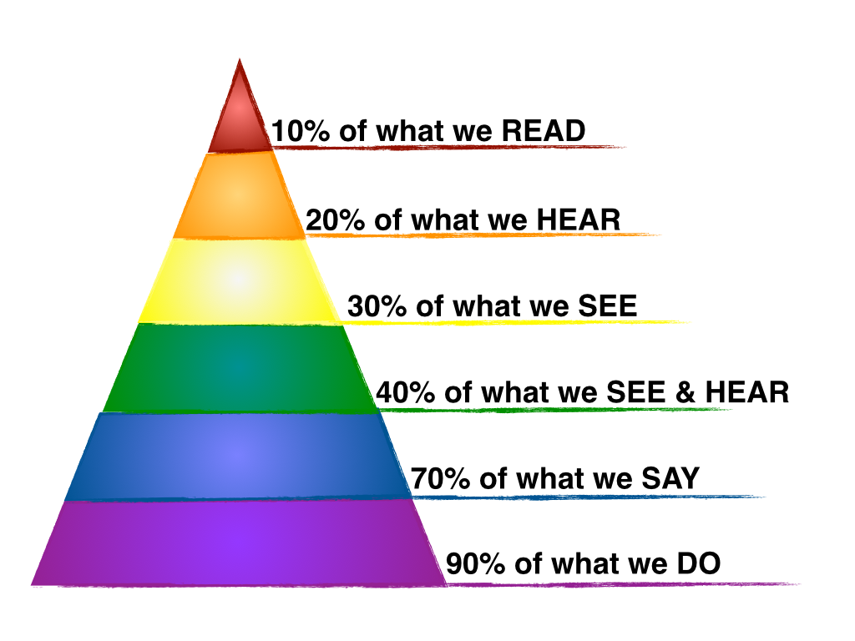
Teaching Adult Learners
The training should be engaging and presented in a respectful manner where learners have an opportunity to share their experiences.
Consider target audience and their learning needs.
who are you going to teach?
what is their background?
will some people need more training than others?

Slide 58
Who is YOUR Audience
General Population
Elderly Population – Prescription Safety (prevention coalition)
People Who Use – Harm Reduction
Youth – Fentanyl and Social Use
Medical Field
Behavioral Health

Slide 59
HOW TO PREVENT OVERDOSE: KEY POINTS
What are some steps people who use illicit drugs can take to reduce their likelihood overdose? What are some things people who use drugs should consider when taking their medication?
What are some of the risk factors for opioid overdose, regardless of the type?

Slide 60
Overdose Response
Let’s review the recommendations for teaching opioid overdose response.

Slide 61
Evaluate for an Overdose
What are the signs and symptoms of opioid overdose?
How quickly does it take for an overdose to occur?

Slide 62
Administer Naloxone
What are the different types / routes of administration of naloxone?
Does Naloxone have an expiration date?
How should it be stored?
Is naloxone dangerous if exposed to heat or cold?

Slide 63
Call 911
Why is it important that someone call 911?

Slide 64
Provide Ventilation Support
What type of ventilation support should an individual provide to a person suspected to have suffered an overdose?
How can they determine what steps to take?

Slide 65
State Efforts
What is the Standing Order Policy in Rhode Island?
Is there an age limit
What do you think are the barriers.

