Slide 1
WELCOME
2023 Harm Reduction Retreat

Slide 3
What Does Harm Reduction Mean To You?

Slide 4
Harm Reduction;
Harm reduction, or harm minimization, refers to a range of public health policies designed to lessen the negative social and/or physical consequences associated with various human behaviors, both legal and illegal
Definition from National Harm Reduction Coalition;
Harm reduction is a set of practical strategies and ideas aimed at reducing negative consequences associated with drug use. Harm Reduction is also a movement for social justice built on a belief in, and respect for, the rights of people who use drugs.

Slide 5
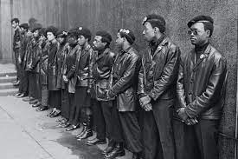
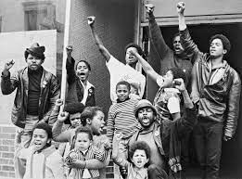
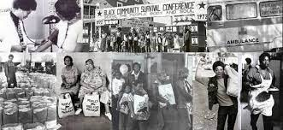

Slide 6
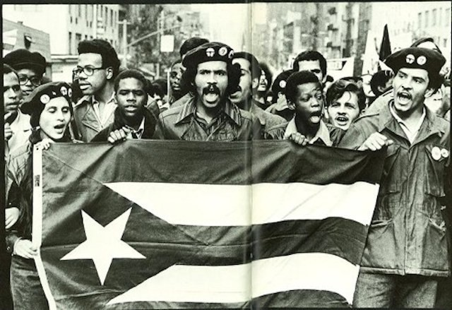

Slide 7
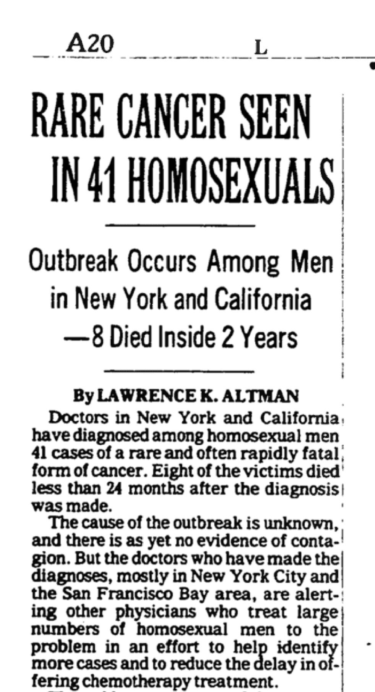

Slide 8
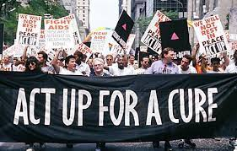
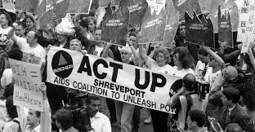

Slide 10
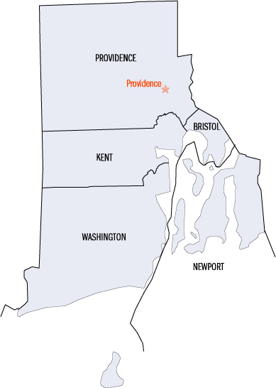
Here In Rhode Island :
In 1994 AIDS Care Ocean State
Created the states first needle exchange program known as ENCORE
Education, Needle exchange, Counseling, Outreach & Referral
- This initiative served as an important need as RI law then prohibited the sale of syringes without a prescription
-Encore served as the states ONLY needle exchange for over 15 years

Slide 12
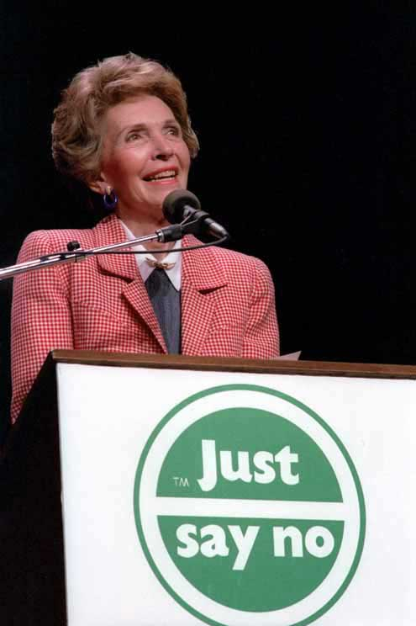

Slide 13
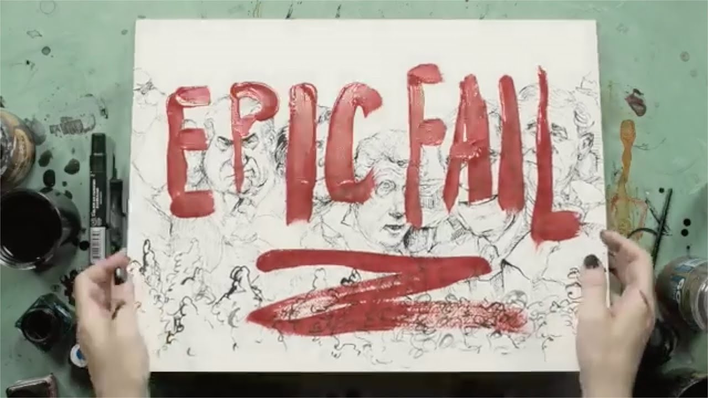

Slide 16
Drug User Advisory Board
Nothing About Us Without Us
Notes:
Tom: Introduce self : drug user/ poly substance use/ homeless/ drug checking through COBRE/ lifespan. The Drug user advisory board is made up of 10 mostly consistent members from both Pawtucket and Woonsocket made up of people who all currently use substances, The advisory board has monthly meetings at both locations where we advise on things like fetynal test strip instructions and xylazine messaging. We have also played on a big part in creating and delivering this training. Introduce other members - Things that we are looking forward to doing in the future is working on a drug user bill of rights for hospitals to adapt and creating our own safest use protocols around our current drug supply in RI.

Slide 17
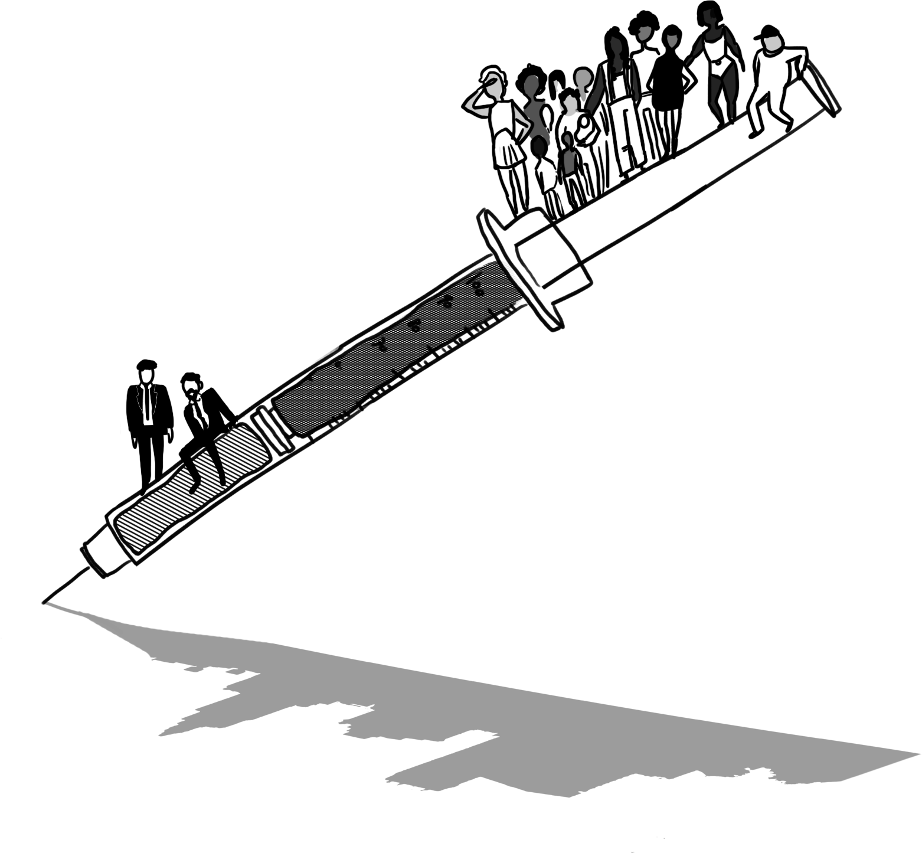
My Experience at a SSP/ Harm Reduction Org.

Slide 18
Learning The Hard Way
8/10 7/10 10/10
Advisory Board members report not knowing their risk of overdose
Advisory Board Members have experienced a overdose
Advisory Board Members Engage with a SSP
Notes:
Read off Slide- ……. One of the reasons we decided to have the harm reduction supply booths today is because although we know were doing a great job at getting safe supplies out there into the hands of people who need them we also recognize we need to do a better job at giving the necessary information in the least stigmatizing way that go with those supplies. We need to recognize that many of our risks go beyond just overdose and that for too many of us SSP are the only place that we do receive information on how to stay healthier.

Slide 19
Notes:
Its great that we offer safe injecting supplies. That being said, how often do we have conversations regarding the other means of harm reduction instead of just clean syringes. I.e. do ppl know that you can be infected from simply sharing a cooker?

Slide 20
Notes:
How many of you have conversations with people aout rotating injection sites to both prevent infection and collapsed veins?. Or alternative ways to use their substance like smoking, boofing, or sniffing.

Slide 21
Notes:
The harsh reality is this is the harm reduction we need. We need to find ways to deliver this critical information that are comfortable

Slide 23
Tips from the Advisory Board
We would like to get our own supplies VS kits
Getting out information to us in community spaces (meetings)
Having alerts on outreach kits and office settings
Making delivery service more available

Slide 24
Where Are We Now?

