Slide 1
Wound Care Examples

Slide 2
Content Warning: Lots of open wounds, pus, etc.
(It’s just all pictures of wounds)

Slide 3
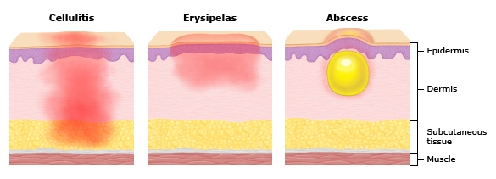

Slide 4
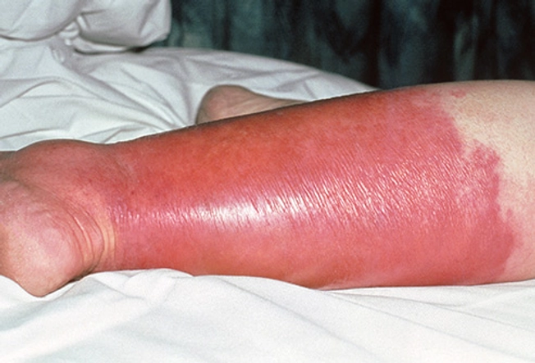
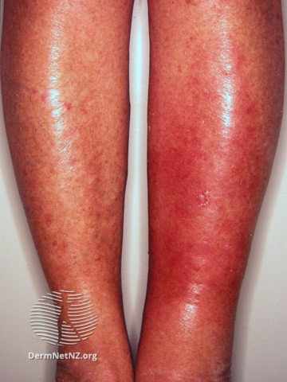
Cellulitis

Slide 5
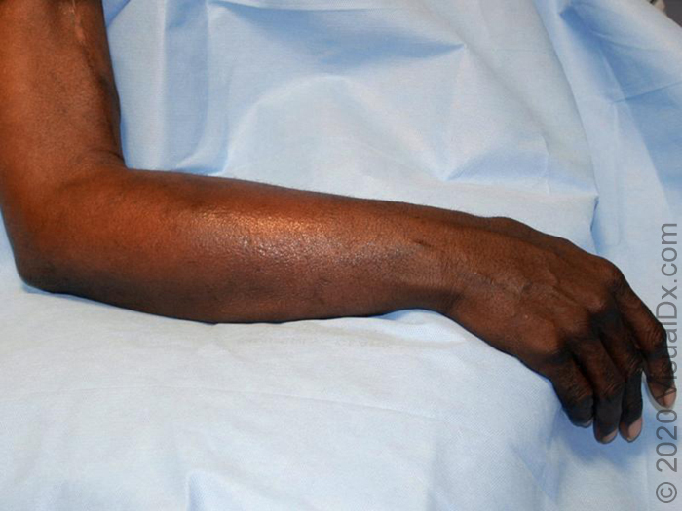
Cellulitis

Slide 6
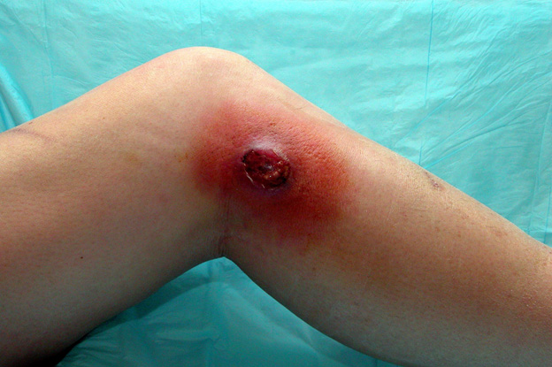
Cellulitis around a wound

Slide 7
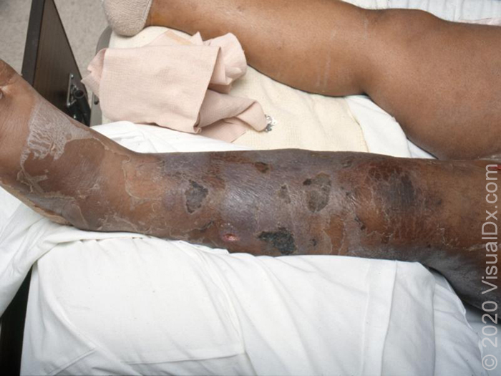
Cellulitis:
Healing

Slide 8
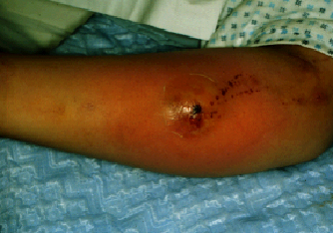
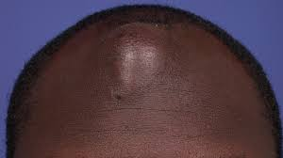
Abscess

Slide 9
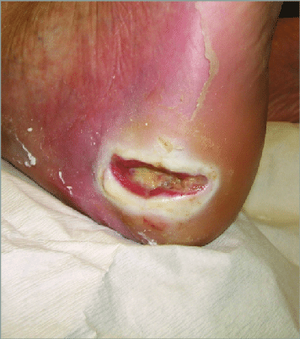
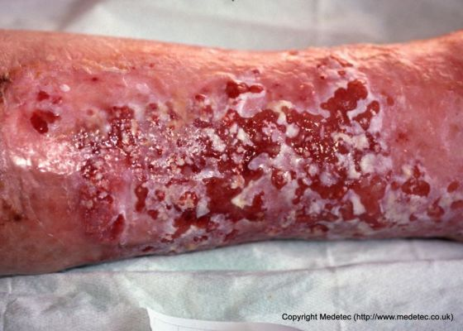
Wet Wounds: Maceration

Slide 10
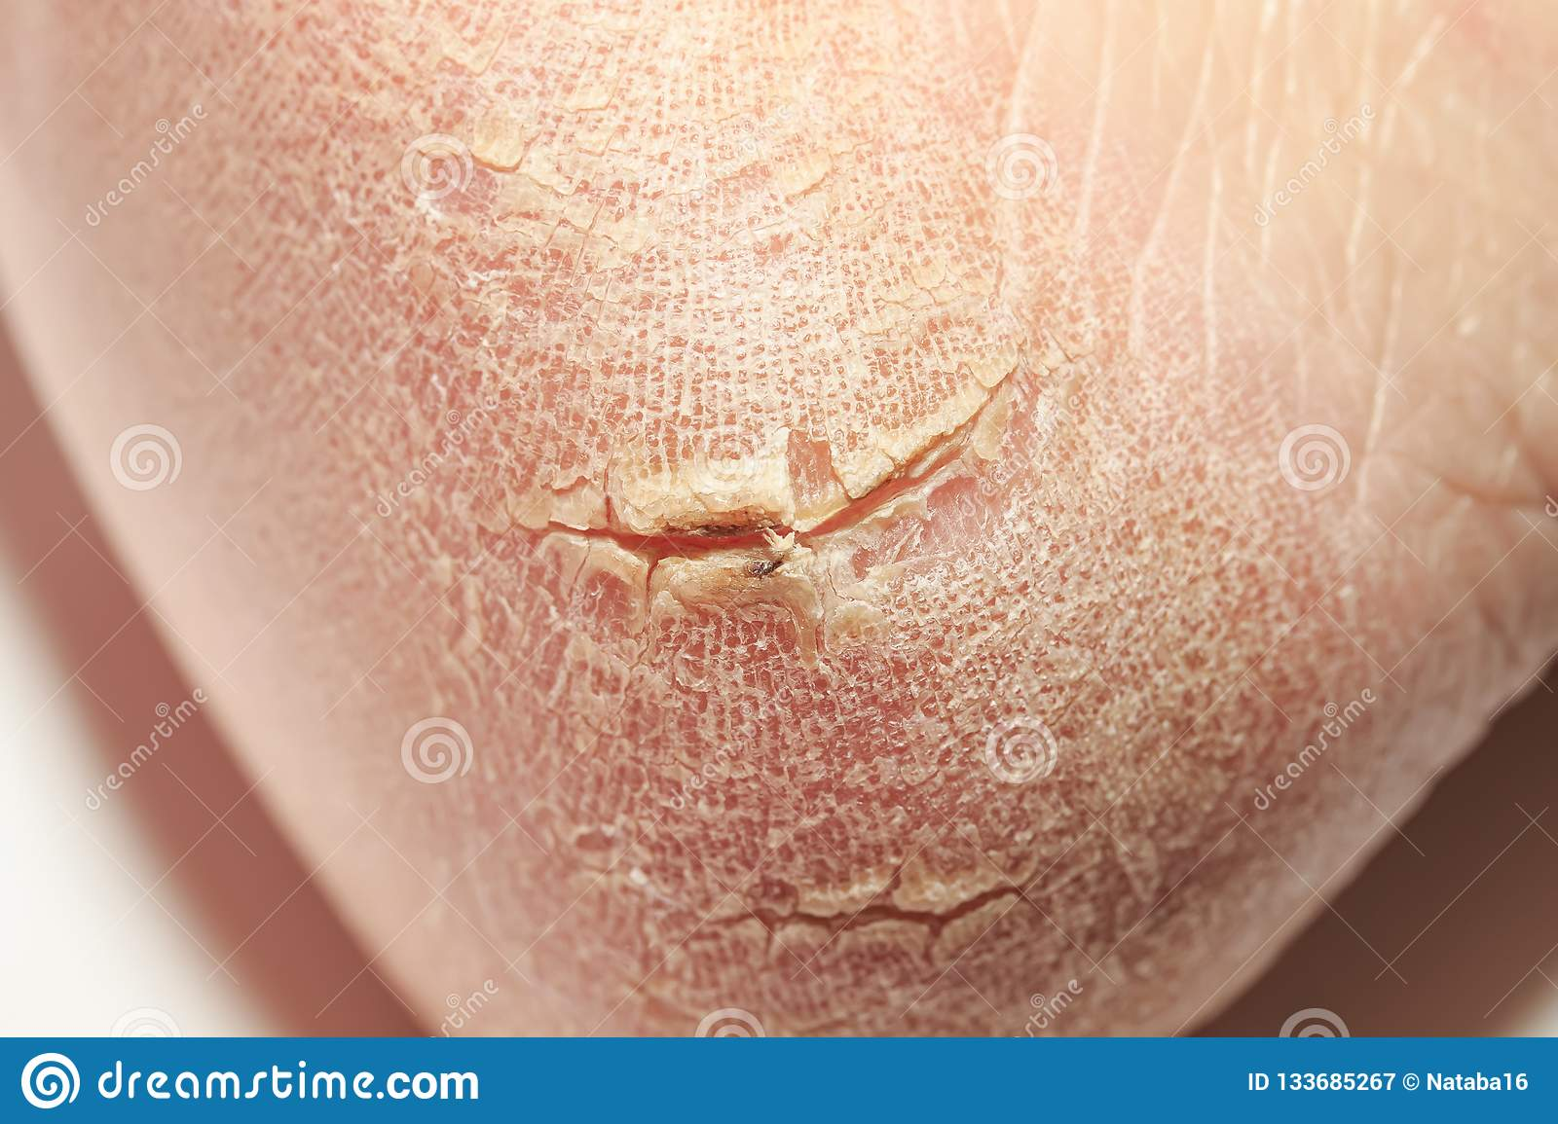
Dry Wounds: Cracking/Flaking

Slide 11
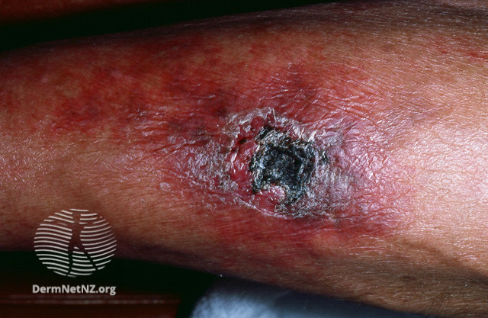
Other Stuff - just FYIs
Black wound bed can mean dead tissue (called “necrosis”). Can be an emergency, usually you will see infection too

Slide 12
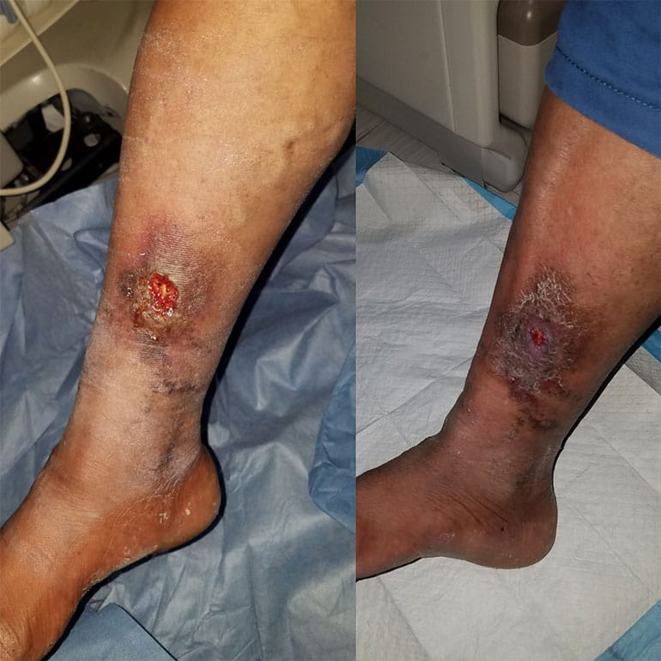
Other Stuff
Skin changes + swollen legs = “Venous stasis.” Treatment = get rid of the fluid by peeing it out (water pill “Lasix”) & compression stockings. Not an emergency but can cause open wounds (“ulcers) if untreated

