Slide 1
Overdose education and naloxone distribution

Slide 2
Objectives
Discuss
Discuss the issues of opioid use and mortality across the country and Rhode Island
Identify
Identify risk factors for overdose
Provide
Provide tools to recognize and respond effectively to an overdose
Administer
Administer naloxone to an individual thought to be experiencing an overdose.
Support
Support Ventilation and Monitor individual for responsiveness.

Slide 3
Opioids and Overdose Nationwide

Slide 4
Opioids and Overdose
The CDC estimates that 80,816 opioid overdose deaths occurred from in 2021

Slide 5
Opioids and Overdose in rhode island

Slide 6
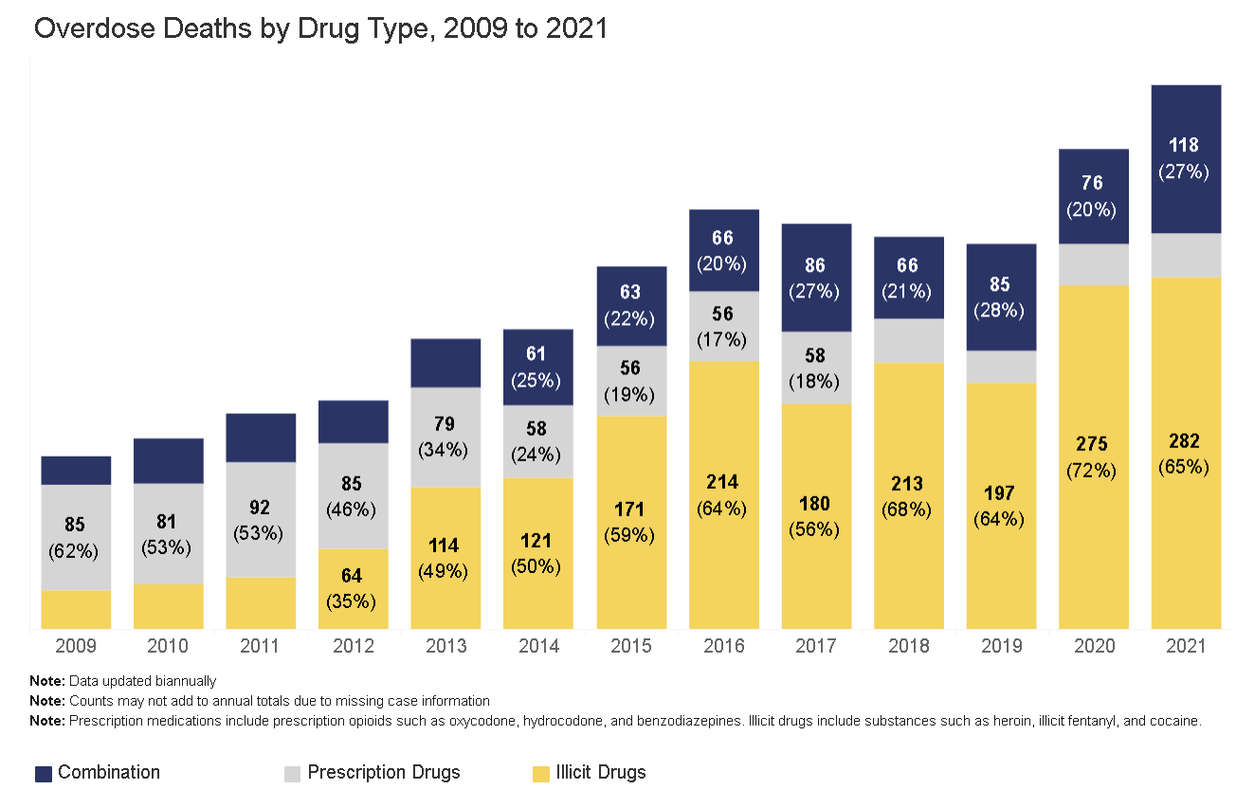
RI Fatal Overdoses 2009-2021
Notes:
This is a busy slide and shows the many waves of the crisis (it is a dynamic epidemic). 1) preventoverdoseri.org is a terrific resource! 2) prescription overdose deaths (in grey)show a decline; 3) 2013-2015 heroin deaths on the rise; 4) 2015 onwards fentanyl deaths on the rise (in 2018, fentanyl was present in 70% of fatal overdoses). While we saw an approximate 8% decline in overdose fatalities 2017-2019, in 2020 RI experienced the highest number of fatal overdoses to date with deaths estimated to exceed 400 (final number won’t be available until April 2021).

Slide 7
DRUG SUPPLY

Slide 8
Waves of the overdose crisis 1 – prescription opioids 2 – heroin 3 – fentanyl 4 – fentanyl in non-opioid substances Xylazine

Slide 9
Opioids

Slide 10
OPIOIDS
STRONG OPIOID AGONISTS
morphine
fentanyl
methadone
heroin
hydromorphone (Dilaudid)
oxycodone (Oxycontin, Percocet*)
meperidine (Demerol)
MODERATE OPIOID AGONISTS
codeine
hydrocodone (Vicodin*)
OTHER OPIOID AGONISTS
tramadol (Ultram)
dextromethophan
PARTIAL OPIOID AGONIST
buprenorphine
buprenorphine+naloxone (Suboxone)
OPIOID ANTAGONISTS
naloxone (Narcan)
naltrexone
*contains acetaminophen (Tylenol)

Slide 11
Overdose Risk Factors Naloxone

Slide 12
Overdose Risk Factors
There is an increased likelihood of overdose when any of the following factors are present:
Presence of fentanyl in non- opioid drugs
Decreased tolerance due abstinence
incarceration
detox
Prior nonfatal overdose
High dose prescription
Using illicit opioids alone
Mixing of prescription/illicit opioids
with benzodiazepines (i.e. Xanax)
with alcohol
with cocaine (or other uppers)
with other substances (i.e. fentanyl)
Compromised health conditions
Hepatitis C
HIV/AIDS
Pneumonia, flu or other acute illness
sleep apnea
other liver or respiratory conditions
Notes:
People lose tolerance to opioids if they stop taking opioids for any reason, including treatment or detox that is not accompanied by medications (i.e. buprenorphine, methadone or naltrexone). So, if the person has a reoccurrence of opioid use, they are at increased risk of overdose, because their body cannot tolerate the same amount they used before.

Slide 13
Naloxone (Narcan)
is used to reverse opioid overdose.
is a non-addictive, prescription drug.
only works on opioids. However, if there are multiple drugs in the system, it can help restore breathing.
can be given as an injection (IM) or as a nasal spray (IN) by lay people.
effect has an onset of 2-4 minutes and a duration of 30- 90 minutes.
is stored at room temperature.
Multiple doses of naloxone are often REQUIRED because of fentanyl.
Notes:
It has a stronger affinity for opioid receptors than opioids and therefore reverses and blocks their effects. There are no adverse effects to naloxone if administered to someone not overdosing on opioids. People who overdose may have different types of drugs in their system

Slide 14
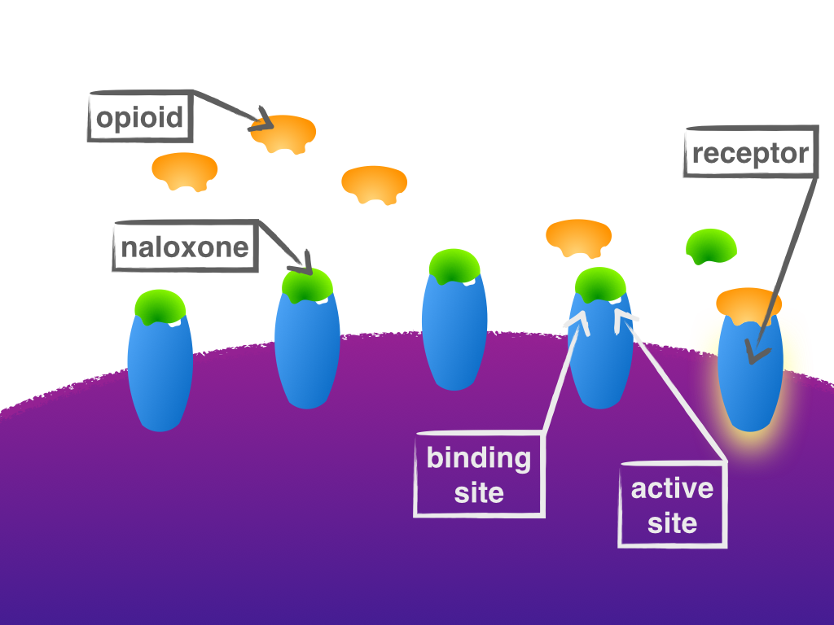
Naloxone
Naloxone works by “pushing” opioids off their receptors.
It then binds to the opioid receptors and blocks opioids from binding.
This rapid removal of opioids from receptors can cause symptoms of withdrawal, although the severity varies from person to person.
The opioids have NOT been removed from the body and re-attach as the naloxone wears off in 30-90 minutes.

Slide 15
Overdose Assessment and Response

Slide 16
Fatal Overdose is Preventable
You are the help until help arrives!!
SURGEON GENERAL ADVISORY
https://www.hhs.gov/surgeongeneral/priorities/opioids-and-addiction/naloxone-advisory/index.html
Notes:
Dr. Jerome Adams issued a surgeon advisory urging Americans to carry naloxone.

Slide 17
Naloxone Video
https://youtu.be/bPBnBtp9Y3c

Slide 18
Overdose Response
Evaluate for an Overdose
Call 911*
Administer naloxone, if available*
Support Ventilation
* If two people available, one call 911, one administer naloxone
If no response after 2-3 minutes, give 2nd dose of naloxone

Slide 19
Evaluate for an Overdose
Can't be woken up (unresponsive) | Pale/Ashen skin
Slow or no breathing (may sound like snoring) | Fingernails or lips turning blue or grey/ashen (lighter color skin will turn purple/blue; darker color skin will turn grey/ashen)
Notes:
Overdose victim may also have a stiff or rigid upper body – this is sometimes a symptom of fentanyl exposure

Slide 20
CALL 911*
AN OPIOID OVERDOSE NEEDS IMMEDIATE MEDICAL ATTENTION.
Be sure to give a specific address and/or description of your location.
* If two people available, one call 911, one administer naloxone

Slide 21
Administer naloxone*
If two people available,
one call 911
one administer naloxone

Slide 22
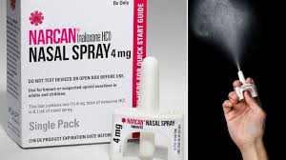
NARCAN Nasal Spray
Remove the device from the package. Hold with thumb on the bottom of the plunger with your first and middle fingers on either side of the nozzle.
Tilt the person’s head back and provide support to the neck then insert the tip of the nozzle into nostril until your fingers are against the person’s nose.
Press the plunger firmly to give the dose.

Slide 23
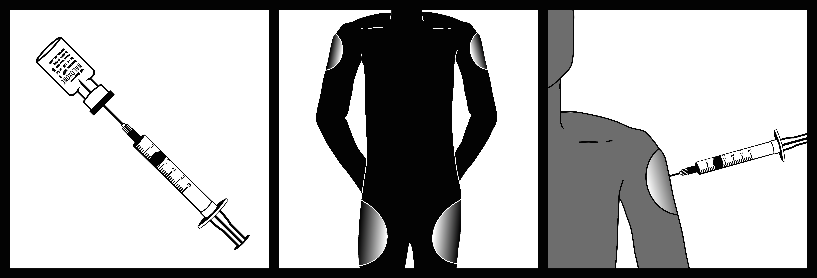
IM Naloxone
Remove cap from naloxone vial and syringe
Insert needle through rubber plug
Pull back on plunger until there is 1cc in the syringe
Inject into a large muscle (thigh or upper arm)

Slide 24
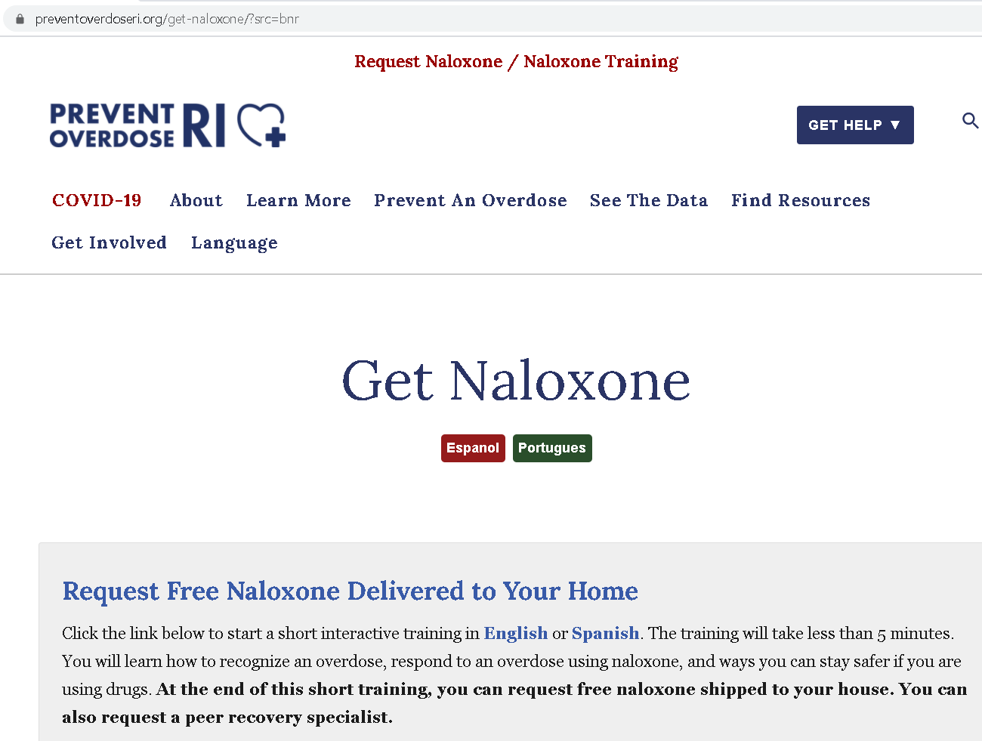

Slide 25
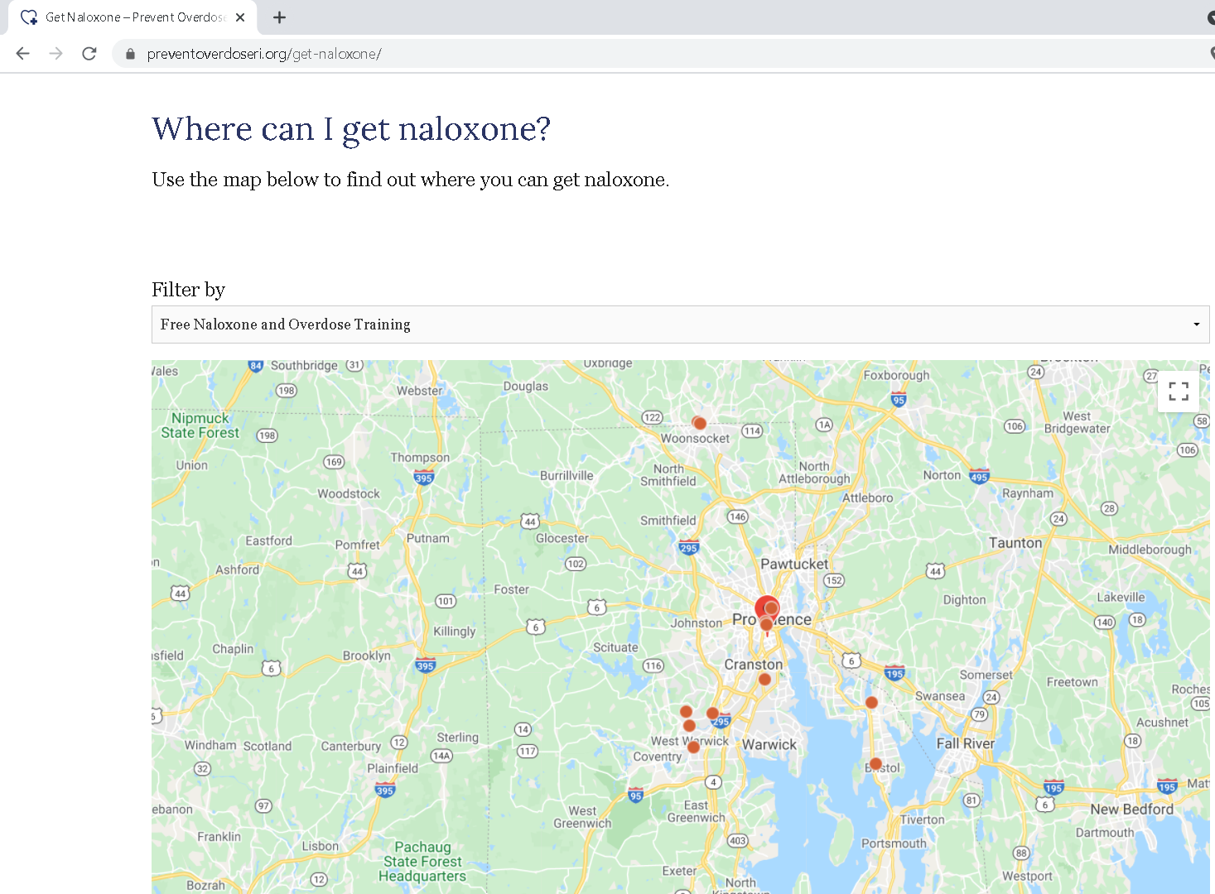

Slide 26
Support Ventilation
Breathing support is an important intervention and may be lifesaving on its own (if naloxone is not available).
Rescue breathing, CPR and/or chest compressions can provide vital support to the individual and improve outcomes.
Notes:
These instructions hold true during COVID-19 as well. People may be less comfortable providing rescue breaths but can support ventilation with chest compressions.

Slide 27
How to Provide Ventilation Support
BASED ON YOUR LEVEL OF TRAINING or COMFORT:
Rescue Breaths
CPR
Full Chest Compression + Rescue Breaths (30 to 2)
Chest Compression Only (100 per minute)
To be fully prepared in the case of an emergency, enroll in a local CPR training.
Notes:
In the instance of a witnessed opioid overdose, rescue breathing is the primary treatment and should be performed after administering naloxone. CPR is a more reliable rescue mechanism if you are unsure of when or if an overdose has occurred. It “covers all the bases” if we aren’t certain of the overdose.

Slide 28
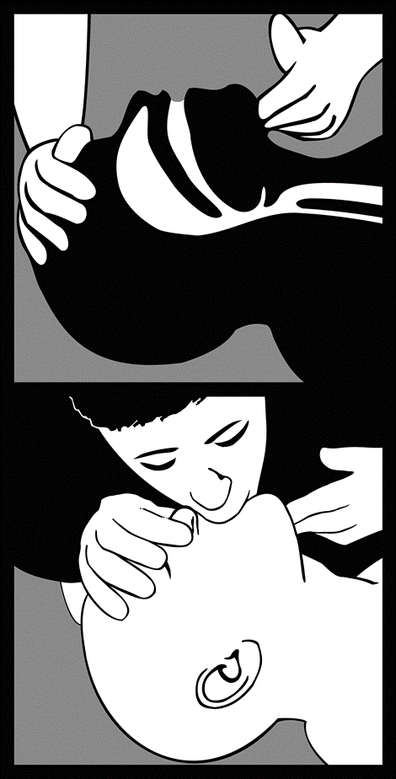
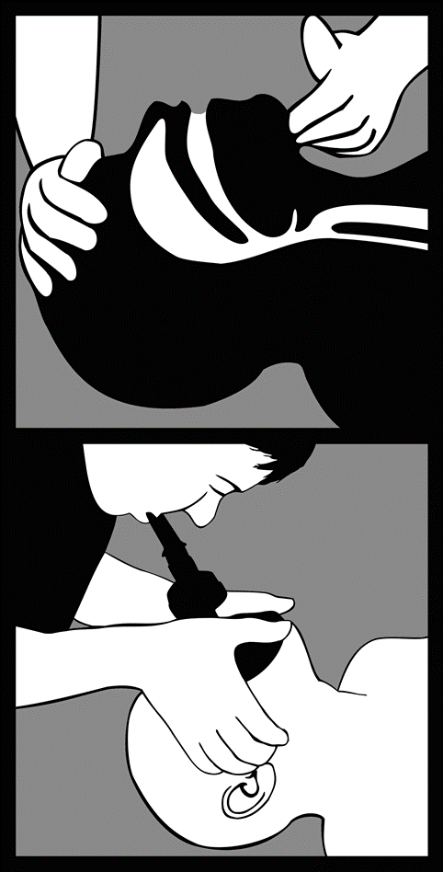
Rescue Breathing
Place one hand on the person’s chin, tilt the head back, and pinch the nose closed.
Place your mouth over the person’s mouth to make a seal and give two slow breaths.
Watch for the person’s chest (but not the stomach) to rise.
Follow up with one breath every 5 seconds.
Continue until help arrives or the person starts breathing on their own.
Use a barrier device, if you have one.

Slide 29
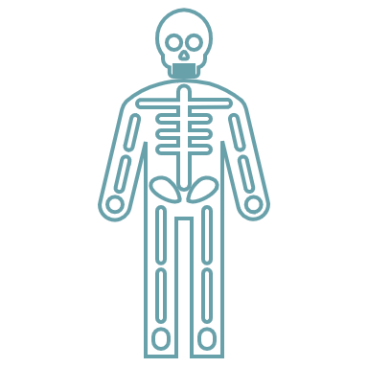
Chest Compressions
Chest compressions for adults involve the following steps:
Place the person on his or her back.
Press hard and fast on the center of the chest.
Interlock fingers.
Keep your arms extended.
Notes:
Shoulders over hands.

Slide 30
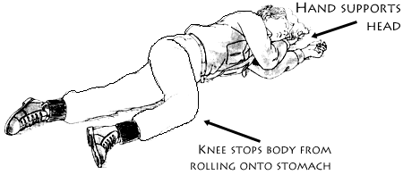
Recovery Position
When To Use The Recovery Position:
If You have to leave for any reason
If the individual begins breathing but remains groggy.
First Responder Training / MADPH
Notes:
If for any reason the victim needs to be left along place in recovery position

Slide 31
Possible Naloxone Responses
Breathing improves and person becomes responsive within 2-3 minutes
Person starts breathing within 2-3 minutes but remains groggy and not fully responsive
Person does not respond to first dose and naloxone must be repeated in 2-3 minutes (continue to provide ventilation support)

Slide 32
Xylazine
What it is :
Xylazine is a long-acting medication used as a veterinary tranquilizer (not an opioid and not approved for human use).
It has been found in the local drug supply in Rhode Island in combination with substances containing fentanyl.
How it affects the body:
Xylazine can cause deep sedation that can last hours. When someone is deeply sedated and doesn’t move for a long time, it can lead to injuries related to poor circulation. This includes skin, soft tissue, muscle, or nerve damage.
Severe and persistent wounds. Wounds may occur even if you do not inject, or in places where you do not inject.
Xylazine, in combination with opioids, can also lead to problems breathing, and increase the chance of overdose.

Slide 33
Increased OD risk factor
Xylazine is a tranquilizer, which compounds the effects of an opioid and further suppresses breathing.
Drugs contaminated with xylazine may not appear any different.
Xylazine can increase the risk of overdose and cause drowsiness, unresponsiveness, slow heart rate, and decreased breathing.

Slide 34
How to respond
If someone is experiencing an overdose, use standard opioid overdose response:
Call 911
Give Naloxone every two minutes until breathing returns
Administer CPR, if you know how in commination with Naloxone
Focus on the breath! Administer Naloxone UNTIL breathing is restored.** Once the person is breathing, place them in the recovery position and remain with them until help arrives.
**They may remain sedated after breathing is restored
Notes:
Put in image of recovery position

Slide 35
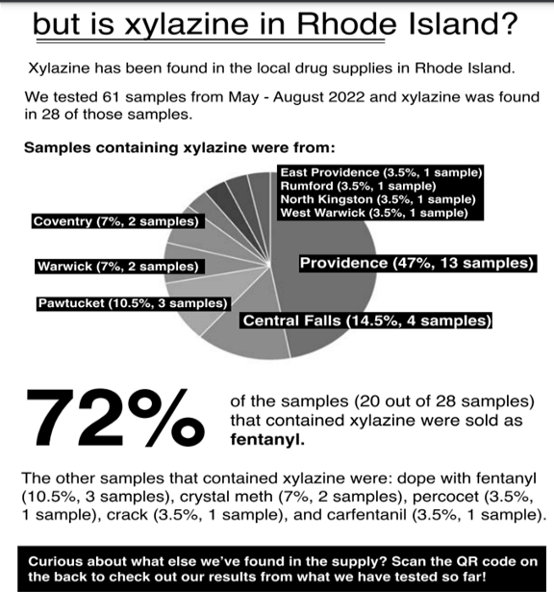
What xylazine looks like from the front lines
Prolonged sedation after responding to an overdose
Wounds in place other than injection place
Partnering to test drug samples to see what is in local supply
28 out of 61 samples tested, Xylazine was present
Educating folks served on safer drug use practices, what to expect when xylazine is present and providing harm reduction services/referral to wound care.

Slide 36
Efforts to address the crisis

Slide 37
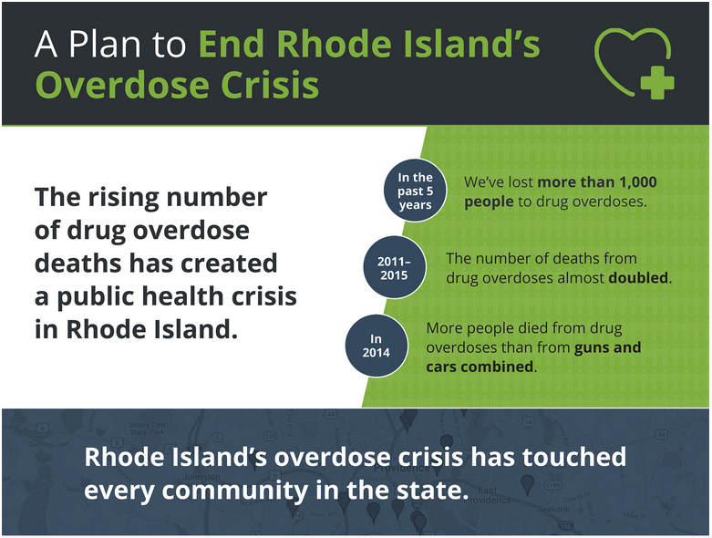
RI Strategic Plan
Notes:
http://preventoverdoseri.org/our-action-plan/

Slide 38
Harm Reduction
Harm reduction refers to public health efforts to minimize harm associated with drug use (or other behaviors), rather than a focus on abstinence from drug use.
Examples of harm reduction programs include:
needle/syringe exchanges
drug testing services (i.e. fentanyl test strips)
decriminalization of drug use
prescribed heroin
overdose prevention centers
information and education

Slide 39
Naloxone Distribution in RI
Notes:
https://preventoverdoseri.org/naloxone-data/
This increase has been due to consistently increasing community distribution of naloxone and in 2018 the law change that requires co-prescription of naloxone with prescription opioids.
http://webserver.rilin.state.ri.us/BillText18/SenateText18/S2930.pdf

Slide 40
Liability / Good Samaritan Law
Civil and criminal immunity for the “good faith” administration of naloxone by a layperson to someone experiencing an overdose.
Anyone who seeks medical assistance for someone experiencing an overdose (e.g. calling 911, performing rescue breathing, administering naloxone) will not be charged with drug possession.
Anyone who experiences a drug overdose and needs medical assistance will not be charged with drug possession.
Neither of these immunities extend to manufacture or distribution of drugs.
The act of providing medical assistance (e.g. calling 911, performing rescue breathing, administering naloxone) may be used as a mitigating factor in criminal prosecution.

Slide 41
Standing Order
Individuals can request, and pharmacists can dispense naloxone without a specific prescription.
There is no age restriction.
Almost all pharmacies in the state are participating.
All insurance, including Medicaid are required to cover the cost of naloxone except for co-pay.
Notes:
It doesn’t have to be for you.

Slide 42
Frequently asked questions

Slide 43
Frequently Asked Questions
What are the side eﬀects of naloxone?
Naloxone reverses opioid overdose and causes withdrawal. The most common symptoms of withdrawal are pain, nausea, vomiting, sweating, and anxiety. Less common are agitation, seizures, or irregular heartbeat. While opioid withdrawal can be dramatic and unpleasant, it is not life threatening.
How many doses are necessary?
It varies. One dose may be enough to let the person start breathing again. Some people may need more than one dose depending on their tolerance, how much they took, and what opioid they overdosed on. Children and people who overdose on synthetic opioids (fentanyl, suboxone, etc) are likely to need multiple doses.

Slide 44
Frequently Asked Questions
Does naloxone work on cocaine, methamphetamine, benzodiazepines, or alcohol?
No. Naloxone only works on opioids (heroin, morphine, fentanyl, methadone, etc). It will not have any effect on someone overdosing on another type of drug. However, if someone is overdosing on opioids AND another drug, naloxone will reverse the opioid part of the overdose and potentially help the person.
What if naloxone is given to someone who doesn't have any opioids in their system?
There are no adverse effects if someone is given naloxone who doesn't need it. If someone looks like they may be overdosing on opioids (unconscious, slow or no breathing), they should be given naloxone. If opioids are present, it will help, if they aren't, it won't hurt.

Slide 45
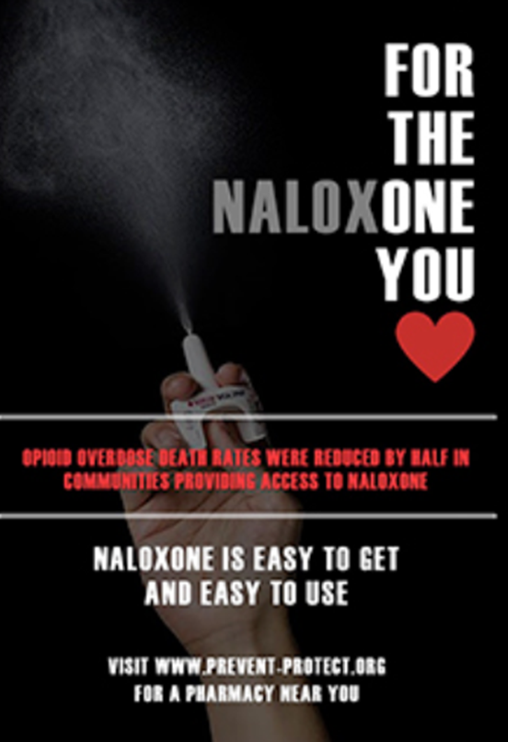
Resources and Materials
Prevent Overdose RI – End the epidemic
PONI (poniri.org)
http://pvdsafestations.com/ - PROVIDENCE SAFE STATIONS - Available 24 hours a day, seven days a week.
https://www.bhlink.org/ FOR CONFIDENTIAL SUPPORT AND TO GET CONNECTED TO CARE: BH LINK CALL 401-414-LINK (5465) OR VISIT their 24-HOUR/7-DAY TRIAGE CENTER
Factsheets
Knowing the Risks of Opioid Prescription Pain Medications 8 1/2 x 11

Slide 46
THANK YOU!
Erin McDonough Michelle McKenzie
RI Medical Reserve Corps The Miriam Hospital
NaloxoBox PONI Preventing Overdose and Naloxone Intervention
emcdonough@ridmat.org mmckenzie@lifespan.org

